Slide 1


ABFRL Galerieslafayette App TSD
25th July 2025

Slide 2
Test Results Summary
Slide 18 – The pageName value for the "Customer Identification Page" is not being captured as expected.
Slide 24 – After clicking the confirm button in the app, userDetails is being recorded as undefined.
Slide 28 – On button click in the mobile app, both userDetails and DOB data are missing.
Slide 35 – Post successful login, userDetails is captured as undefined when the app redirects to the home page screen.
Slide 42 – After the search page loads, the tagging code is not executing.
Slide 44 – PLP sort filter values are not being captured correctly. When the user clicks "New Arrivals," default values are being recorded. This issue will be discussed further to identify a solution.
Slides 46 & 51 – On "Add to Cart" CTA button click, eVar34 (Product Color) is missing in the s.product syntax.
Slide 53 – PLP sort and filter clicks are capturing incorrect values.
Slide 58 – linkpageName is expected to capture "Product Page" but is incorrectly capturing "Product Listing Page".
PLP Page load – Multiple pixels are firing like sort, filtering options selection, etc..

Slide 3

Generic Tags

Slide 4
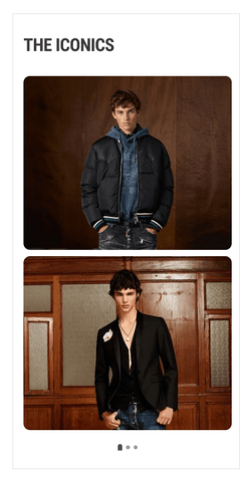
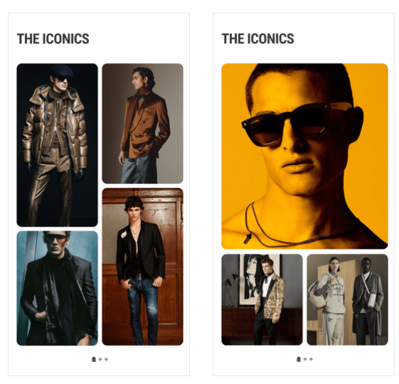
On any banner/image/widget
click

Slide 5
Click Type | Tracking Type | Launch variables | Expected Values
Any Banner click or Widget click | All CTAs | const xdmData = {'eventType': 'analytics.track'}; const adobeDatalayer = { __adobe:{ analytics:{ linkType: 'o’, events: "event2", contextData:{ linkName : “banner click", channel: "<android/ios>|<page name without the word “page”>", // eg : home, category, customerID : "<customerID>", // only pass when available linkPageName: “<page name>", //the name of the page from where the product was clicked, eg : home page, product listing page , etc. loginStatus : "<logged-in/guest>" , icid : "<page type>|<banner name/image name>|<widget name>|<category>|<cta name>|<cta position>", //if a banner or widget is clicked platform: "<android/ios>", userDetails: "<gender>|<age>", // pass only when user is logged in dob: "<date of birth>", // pass only when user is logged in adobeAnalyticsVersion: “aepedge”, eventType: 'click' } } } }; let experienceEvent = new ExperienceEvent({ xdmData: xdmData, data: adobeDatalayer }); Edge.sendEvent(experienceEvent) | loginStatus may have the values:- logged-in guest icid will be passed when a banner or widget is clicked. icid should always be passed in the given format only. Pass na if any value is missing. Example value :- home page|na|sherwanis|sauve silhouettes|explore|1 // considering it as a widget, hero banner or image name will be passed as “na”. home page|sale|na|hero banner |explore|1 // considering it as a banner, here widget name will be passed as “na”.

Slide 6
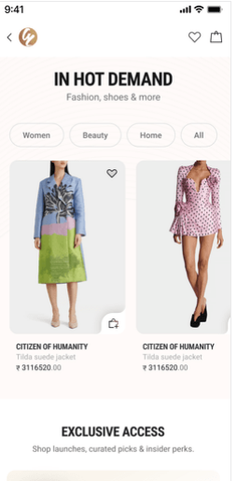
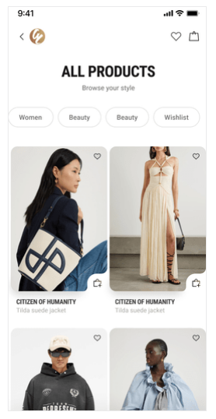
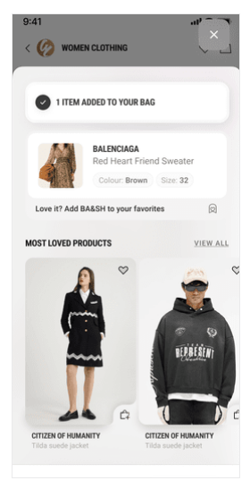
On Any Products click(from Home to Cart)

Slide 7
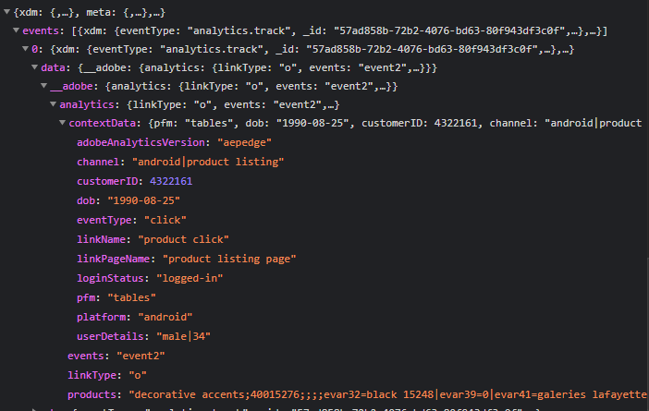
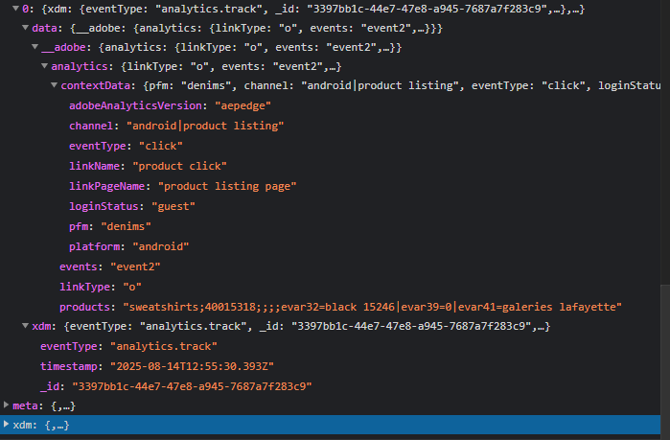
Click Type | Tracking Type | Launch variables | Expected Values
Product clicks | Product click | const xdmData = { eventType: 'analytics.track' }; const adobeDatalayer = { __adobe: { analytics: { linkType: 'o’, events: "event2", // Products syntax with dynamic placeholders products: "<product category>;<product id>;;;;eVar32=<product name>|eVar39=<position of the product clicked>|eVar41=<brand of the product>", contextData: { linkName: "product click", channel: "<android/ios>|<page name without the word 'page'>", // e.g., home, category linkPageName: “<page name>", //the name of the page from where the product was clicked, eg : home page, product listing page , etc. customerID: "<customerID>", // only pass when available loginStatus: "<logged-in/guest>", pfm: "<section of the page/ product finding source>", platform: "<android/ios>", userDetails: "<gender>|<age>", // only when user is logged in dob: "<date of birth>", // only when user is logged in adobeAnalyticsVersion: "aepedge", eventType: "click" } } } }; let experienceEvent = new ExperienceEvent({ xdmData: xdmData, data: adobeDatalayer }); Edge.sendEvent(experienceEvent); | loginStatus may have the values:- logged-in guest pfm means product finding method, the expected values will be the section of the page from where the user has found the product. Eg : “home product slider” “internal search” “internal campaign” “similar products” “top picks” “breadcrumb” “navigation/browsing” “promos” “wishlist/favorites” “collections” “cross-Sell” “campaign landing pages”

Slide 8
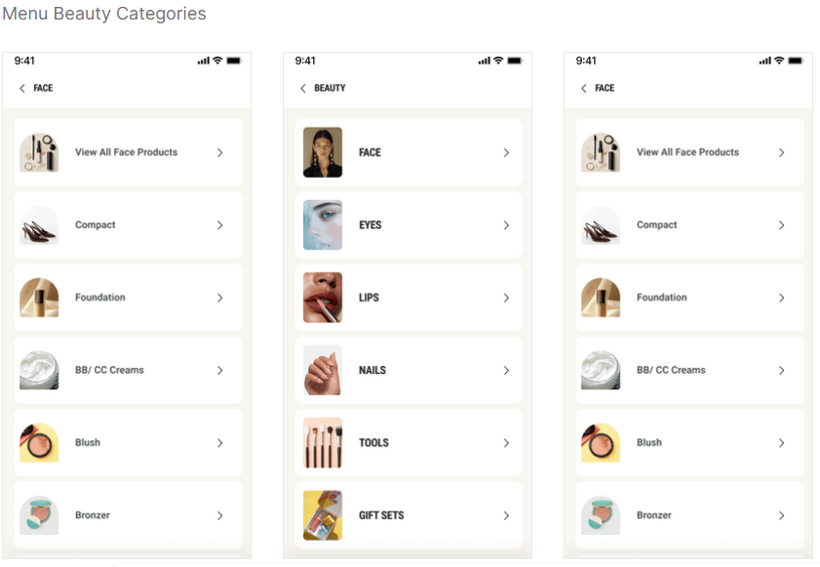
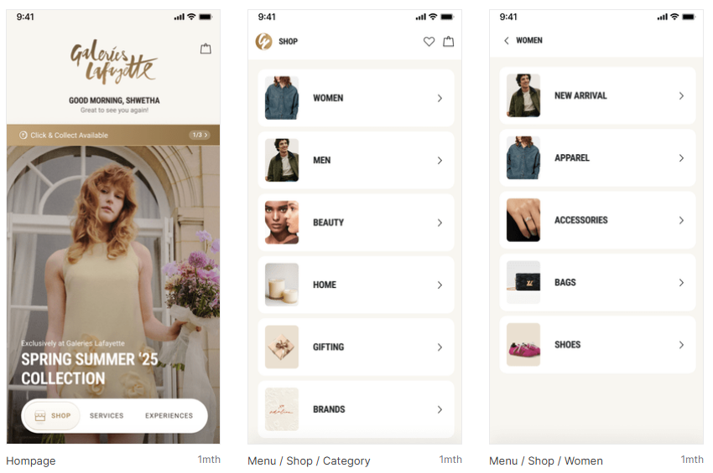
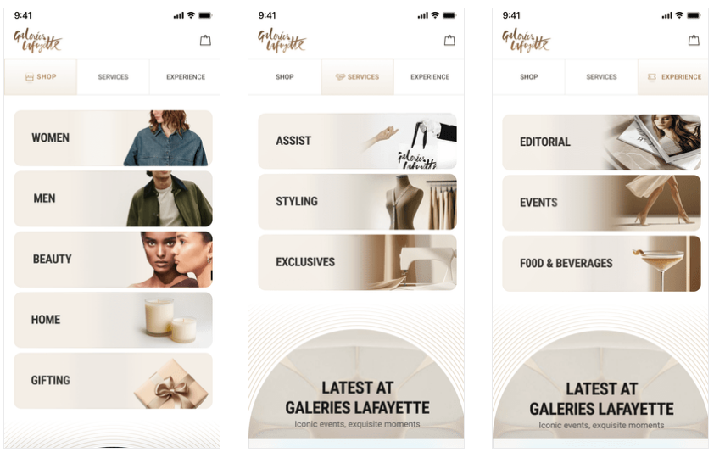
Menu Navigation

Slide 9
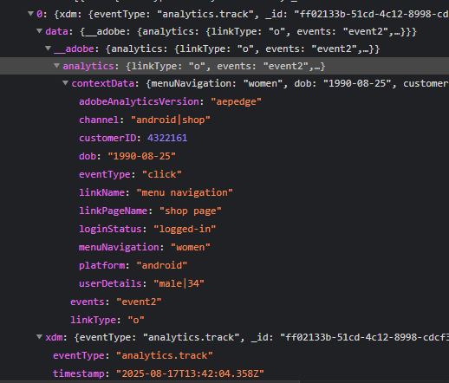
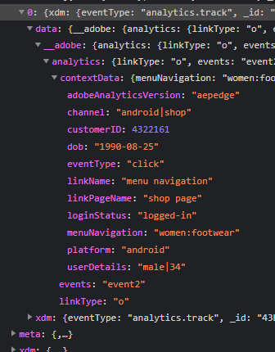
Click Type | Tracking Type | Launch variables | Expected Values
Menu Navigation | Menu CTAs | const xdmData = { eventType: 'analytics.track' }; const adobeDatalayer = { __adobe: { analytics: { linkType: ’o’, events: "event2", contextData: { linkName: "menu navigation", channel: "<android/ios>|<page name without the word 'page'>", // e.g., home, category</page name without the word 'page'> linkPageName: "<page name from where the menu was clicked>", //e.g..page name from where the menu was clicked> menuNavigation: "<section 1 : section 2 : … : section n>” // menuNavigation : “beauty:lips:lipstick”, customerID: "<customerID>", // only pass when available loginStatus: "<logged-in/guest>", platform: "<android/ios>", userDetails: "<gender>|<age>", // only when user is logged in dob: "<date of birth>", // only when user is logged in adobeAnalyticsVersion: "aepedge", eventType: "click" } } } }; let experienceEvent = new ExperienceEvent({ xdmData: xdmData, data: adobeDatalayer }); Edge.sendEvent(experienceEvent); | loginStatus may have the values:- logged-in guest menuNavigation will have the value in the hierarchy Eg : menuNavigation : “beauty:lips:lipstick”,

Slide 10
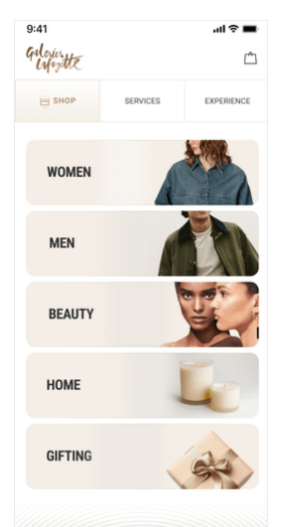
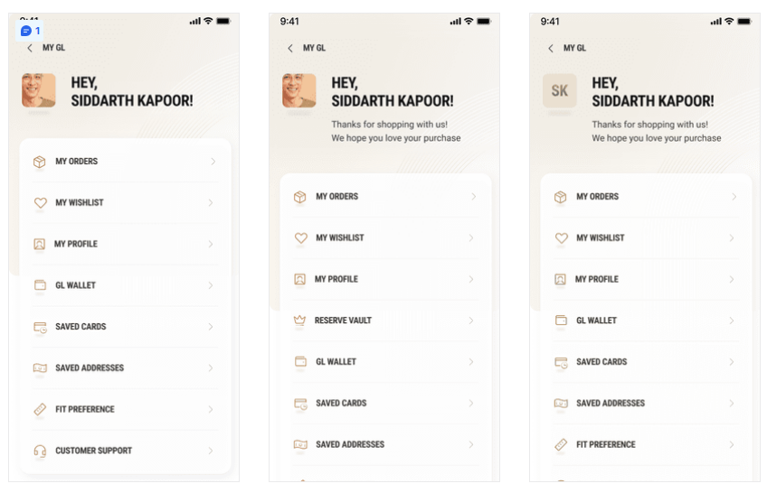
Header CTAs

Slide 11
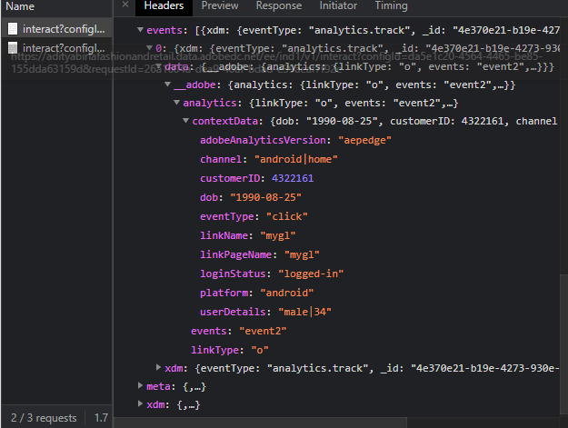
Click Type | Tracking Type | Launch variables | Expected Values
Header CTAs | All CTAs | const xdmData = { eventType: 'analytics.track' }; const adobeDatalayer = { __adobe: { analytics: { linkType: 'o’, events: "event2", contextData: { linkName: "<cta name>", channel: "<android/ios>|<page name without the word 'page'>", // e.g., home, product listing linkPageName: "<page name from where the icons/logo was clicked>", customerID: "<customerID>", // only pass when available loginStatus: "<logged-in/guest>", platform: "<android/ios>", userDetails: "<gender>|<age>", // only when user is logged in dob: "<date of birth>", // only when user is logged in adobeAnalyticsVersion: "aepedge", eventType: "click" } } } }; let experienceEvent = new ExperienceEvent({ xdmData: xdmData, data: adobeDatalayer }); Edge.sendEvent(experienceEvent); Notes: In linkName, the recommendation to track cta name along with the “cta type|cta name” /cta type = header | loginStatus may have the values:- logged-in guest <cta name> will have values like 1. logo 2. my wishlist 3. profile 4. cart 5. Find store 6. Track orders etc

Slide 12
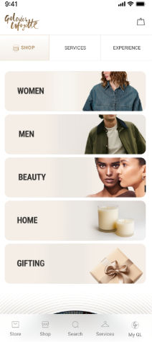
Footer All CTAs

Slide 13
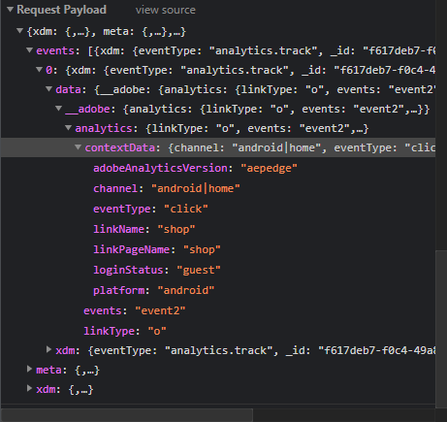
Click Type | Tracking Type | Launch variables | Expected Values
Footer CTAs | All CTAs | const xdmData = { eventType: 'analytics.track' }; const adobeDatalayer = { __adobe: { analytics: { linkType: 'o’, events: "event2", contextData: { linkName: "<cta name>", channel: "<android/ios>|<page name without the word 'page'>", // e.g., home, product listing linkPageName: "<page name from where the icons/logo was clicked>", customerID: "<customerID>", // only pass when available loginStatus: "<logged-in/guest>", platform: "<android/ios>", userDetails: "<gender>|<age>", // only when user is logged in dob: "<date of birth>", // only when user is logged in adobeAnalyticsVersion: "aepedge", eventType: "click" } } } }; let experienceEvent = new ExperienceEvent({ xdmData: xdmData, data: adobeDatalayer }); Edge.sendEvent(experienceEvent); Notes: In linkName, the recommendation to track cta name as a “cta type|cta name” /cta type = footer | loginStatus may have the values:- logged-in guest

Slide 14
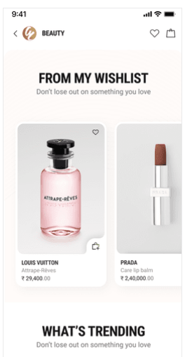
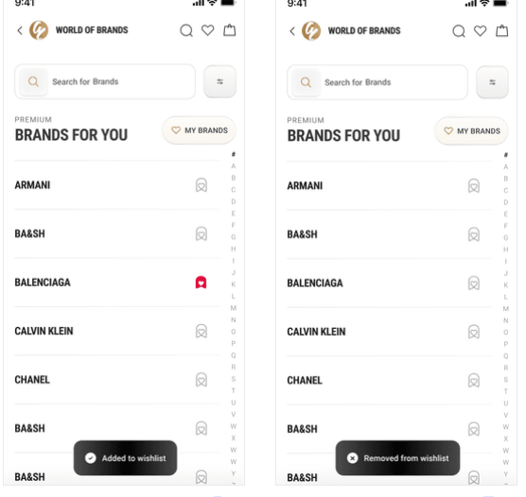
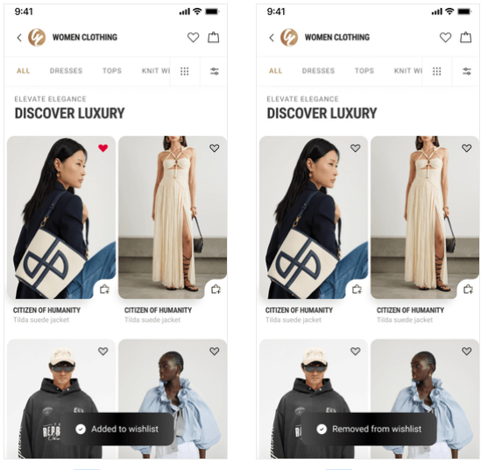
On wishlist add or remove

Slide 15
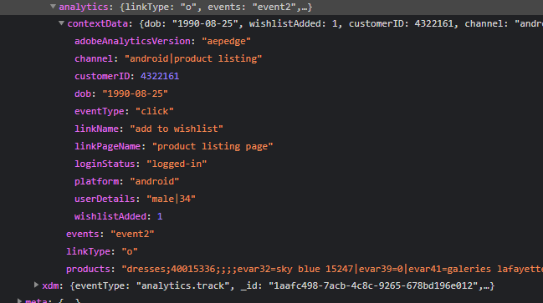
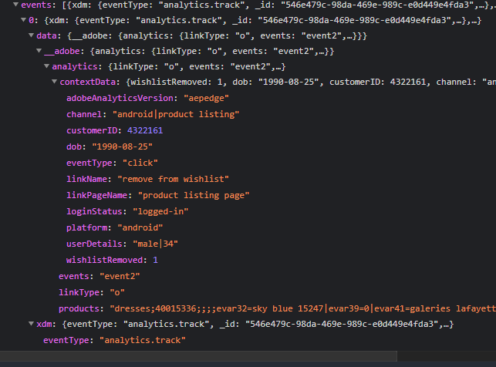
Click Type | Tracking Type | Launch variables | Expected Values
Add to wishlist | Icon | const xdmData = { eventType: 'analytics.track' }; const adobeDatalayer = { __adobe: { analytics: { linkType: 'o', events: "event2", // Updated products syntax with quantity and price products: "<product category>;<product ID>;;;;eVar32=<product name>|eVar39=<product position>|eVar41=<brand of the product>", contextData: { linkName: "<add to wishlist/remove from wishlist>", wishlistAdded: 1, // only include if product is added to wishlist, wishlistRemoved: 1, // only include if product is removed from wishlist, channel: "<android/ios>|<page name without the word 'page'>", // e.g., home, category linkPageName: "<page name from where this event happened>", customerID: "<customerID>", // only pass when available loginStatus: "<logged-in/guest>", platform: "<android/ios>", userDetails: "<gender>|<age>", // only when user is logged in dob: "<date of birth>", // only when user is logged in adobeAnalyticsVersion: "aepedge", eventType: "click" } } } }; let experienceEvent = new ExperienceEvent({ xdmData: xdmData, data: adobeDatalayer }); Edge.sendEvent(experienceEvent); Note: As per sdk event10 and event11 is a counter events but web tech spec highlighted to pass numeric value. Above red color item discussed and then deleted | loginStatus may have the values:- logged-in guest productID: will have the value of SKU ID of the product. productCategory: will have the category of the product. productName: name of the product.

Slide 16
Sign in & Sign Up

Slide 17
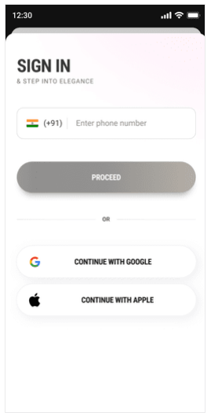
Identification Page Load

Slide 18
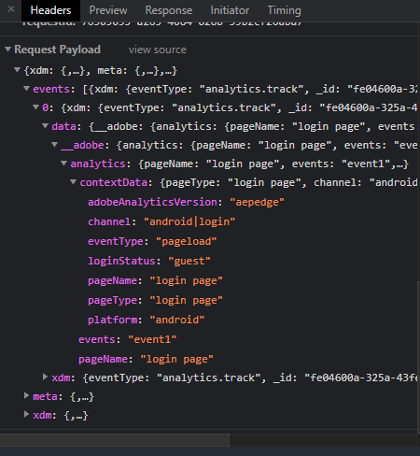
Page Type | Tracking Type | Launch variables | Expected Values
CI Page | Onload | const xdmData = { eventType: 'analytics.track' }; const adobeDatalayer = { __adobe: { analytics: { pageName: "customer identification page", events: "event1", contextData: { pageName: "customer identification page", channel: "<android/ios>|login & registration", customerID: "<customerID>", // only pass when available loginStatus: "<logged-in/guest>", platform: "<android/ios>", userDetails: "<gender>|<age>", // only when user is logged in dob: "<date of birth>", // only when user is logged in adobeAnalyticsVersion: "aepedge", eventType: "pageload" } } } }; let experienceEvent = new ExperienceEvent({ xdmData: xdmData, data: adobeDatalayer }); Edge.sendEvent(experienceEvent);

Slide 19
All CTA’s

Slide 20
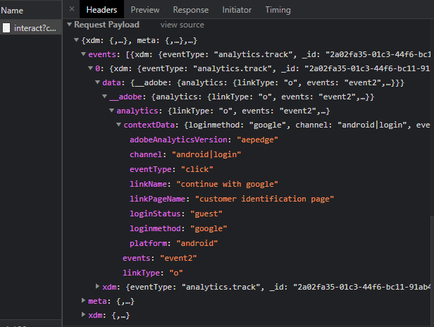
Click Type | Tracking Type | Launch variables | Expected Values
Buttons click | All CTAs | const xdmData = { eventType: 'analytics.track' }; const adobeDatalayer = { __adobe: { analytics: { linkType: 'o’, events: "event2", contextData: { linkName: "<cta name>", channel: "<android/ios>|login & registration", linkPageName: "customer identification page", loginStatus: "guest", platform: "<android/ios>", adobeAnalyticsVersion: "aepedge", eventType: "click" } } } }; let experienceEvent = new ExperienceEvent({ xdmData: xdmData, data: adobeDatalayer }); Edge.sendEvent(experienceEvent);

Slide 21
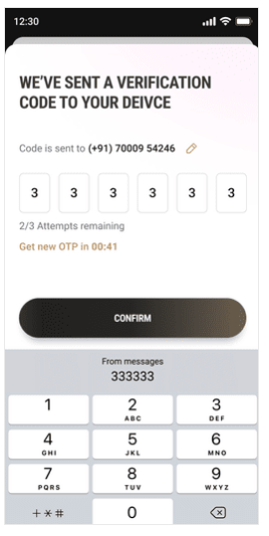
Sign in – OTP verify

Slide 22
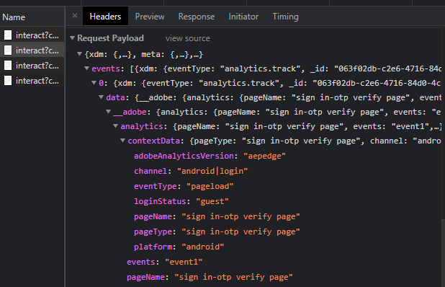
Page Type | Tracking Type | Launch variables | Expected Values
Sign In - OTP | onload | const xdmData = { eventType: 'analytics.track' }; const adobeDatalayer = { __adobe: { analytics: { pageName: "sign in–otp verify", events: "event1", contextData: { pageName: "sign in–otp verify", channel: "<android/ios>|login & registration", loginStatus: "guest", pageType: "sign in–otp verify", platform: "<android/ios>", adobeAnalyticsVersion: "aepedge", eventType: "pageload" } } } }; let experienceEvent = new ExperienceEvent({ xdmData: xdmData, data: adobeDatalayer }); Edge.sendEvent(experienceEvent);

Slide 23
Sign in – Log in CTA click

Slide 24
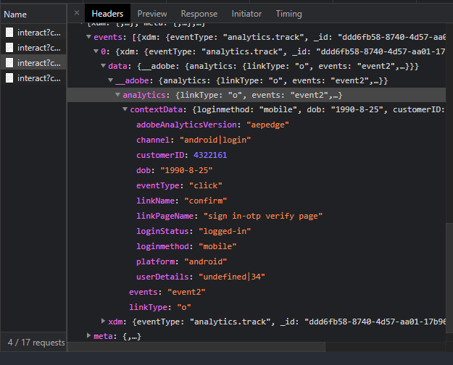
Click Type | Tracking Type | Launch variables | Expected Values
Buttons click | Submit CTAs | const xdmData = { eventType: 'analytics.track' }; const adobeDatalayer = { __adobe: { analytics: { linkType: 'o’, events: "event2", contextData: { linkName: “confirm", loginSuccess: 1, // only pass when login is successful channel: "<android/ios>|login & registration", linkPageName: "sign in-otp verify", customerID: "<customerID>", // only pass when available dob:”<date of birth>”, userDetails: “<gender|age>”, loginStatus: "logged-in", loginmethod: “<mobile/email/google/apple>", platform: "<android/ios>", adobeAnalyticsVersion: "aepedge", eventType: "click" } } } }; let experienceEvent = new ExperienceEvent({ xdmData: xdmData, data: adobeDatalayer }); Edge.sendEvent(experienceEvent);

Slide 25
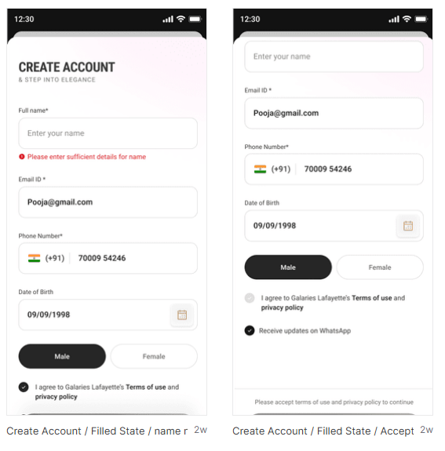
Sign Up Details Page

Slide 26
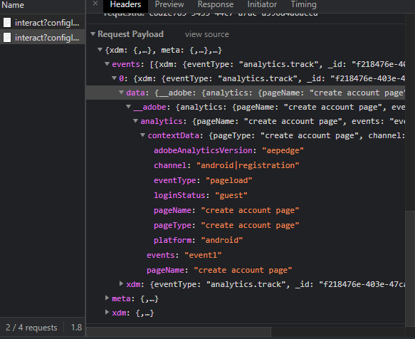
Page Type | Tracking Type | Launch variables | Expected Values
Sign Up | onload | const xdmData = { eventType: 'analytics.track' }; const adobeDatalayer = { __adobe: { analytics: { pageName: "create account page", events: "event1", contextData: { pageName: "create account page", channel: "<android/ios>|login & registration", loginStatus: "guest", pageType: "create account page", platform: "<android/ios>", adobeAnalyticsVersion: "aepedge", eventType: "pageload" } } } }; let experienceEvent = new ExperienceEvent({ xdmData: xdmData, data: adobeDatalayer }); Edge.sendEvent(experienceEvent);

Slide 27
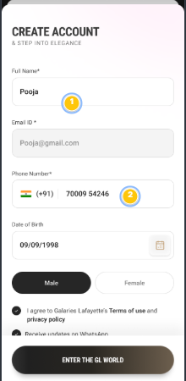
Sign Up – CTA’s click

Slide 28
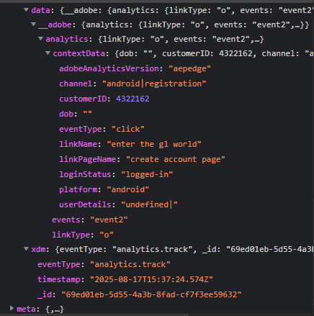
Click Type | Tracking Type | Launch variables | Expected Values
Buttons click | Enter the gl world | const xdmData = { eventType: 'analytics.track' }; const adobeDatalayer = { __adobe: { analytics: { linkType: 'o’, events: "event2", contextData: { linkName: "enter the gl world", regSuccess: 1, // only pass when registration is successful channel: "<android/ios>|login & registration", linkPageName: "create account page", customerID: "<customerID>", // only pass when available loginStatus: "logged-in", platform: "<android/ios>", adobeAnalyticsVersion: "aepedge", eventType: "click" } } } }; let experienceEvent = new ExperienceEvent({ xdmData: xdmData, data: adobeDatalayer }); Edge.sendEvent(experienceEvent);

Slide 29
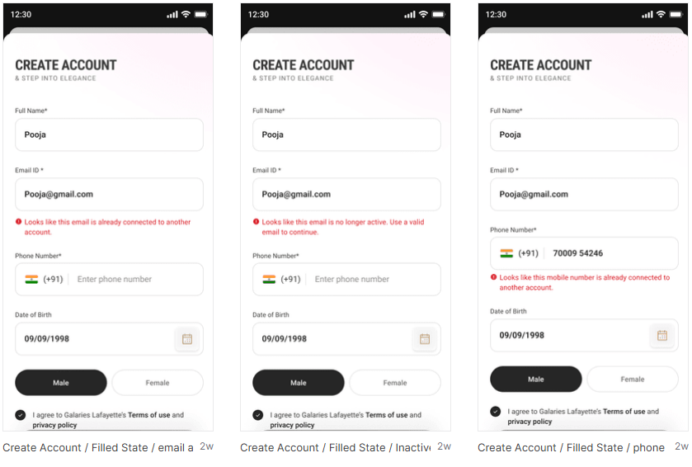
Sign In/Up – Error Tracking

Slide 30
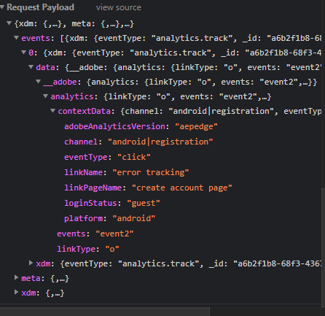
Click Type | Tracking Type | Launch variables | Expected Values
Buttons click | All CTAs | const xdmData = { eventType: 'analytics.track' }; const adobeDatalayer = { __adobe: { analytics: { linkType: 'o’, events: "event2", contextData: { linkName: “error tracking", channel: "<android/ios>|login & registration", linkPageName: "customer identification page", error: "<error statement>", loginStatus: "guest", platform: "<android/ios>", adobeAnalyticsVersion: "aepedge", eventType: "click" } } } }; let experienceEvent = new ExperienceEvent({ xdmData: xdmData, data: adobeDatalayer }); Edge.sendEvent(experienceEvent);

Slide 31
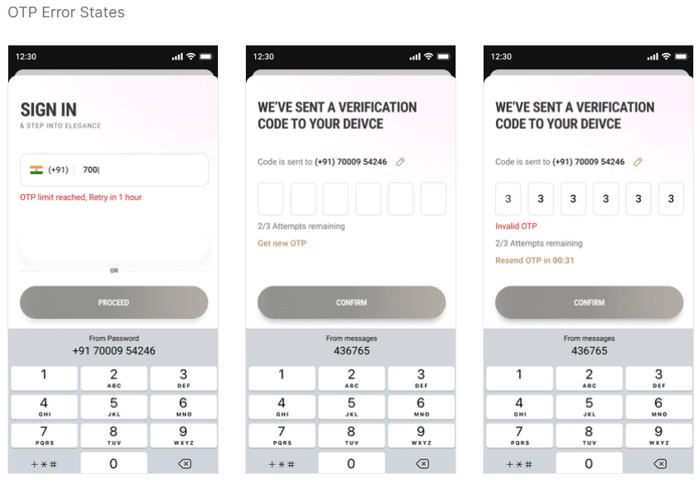
Sign In/Up – OTP Error Tracking

Slide 32
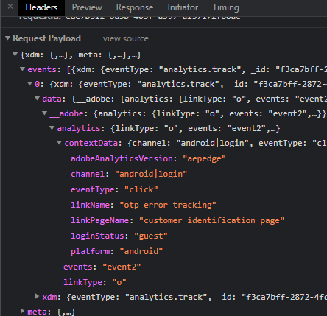
Click Type | Tracking Type | Launch variables | Expected Values
Buttons click | All CTAs | const xdmData = { eventType: 'analytics.track' }; const adobeDatalayer = { __adobe: { analytics: { linkType: 'o’, events: "event2", contextData: { linkName: "otp error tracking", channel: "<android/ios>|login & registration", linkPageName: "customer identification page", error: "<OTP error statement>", loginStatus: "guest", platform: "<android/ios>", adobeAnalyticsVersion: "aepedge", eventType: "click" } } } }; let experienceEvent = new ExperienceEvent({ xdmData: xdmData, data: adobeDatalayer }); Edge.sendEvent(experienceEvent);

Slide 33
Home Page

Slide 34
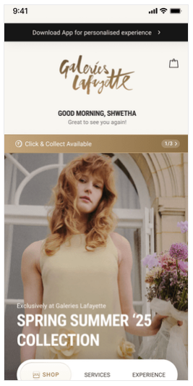
On the Load of Home Page

Slide 35
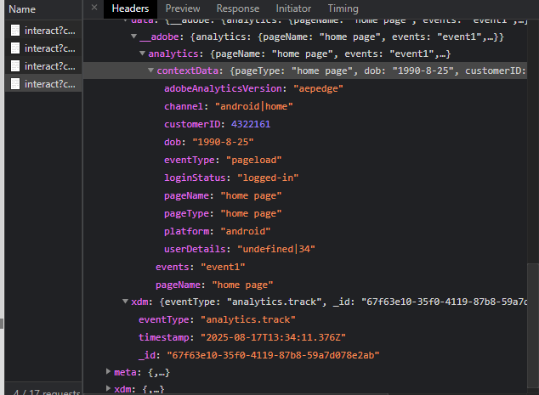
Page Type | Tracking Type | Launch variables | Expected Values
Home page | onload | const xdmData = { eventType: 'analytics.track' }; const adobeDatalayer = { __adobe: { analytics: { pageName: "home page", events: "event1", contextData: { pageName: "home page", channel: "<android/ios>|home", customerID: "<customerID>", // only pass when available loginStatus: "<logged-in/guest>", pageType: "home page", platform: "<android/ios>", userDetails: "<gender>|<age>", // only when user is logged in dob: "<date of birth>", // only when user is logged in adobeAnalyticsVersion: "aepedge", eventType: "pageload" } } } }; let experienceEvent = new ExperienceEvent({ xdmData: xdmData, data: adobeDatalayer }); Edge.sendEvent(experienceEvent); | loginStatus may have the values:- logged-in Guest

Slide 36
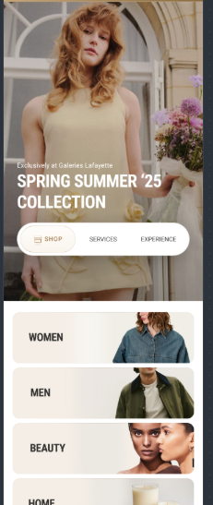
All Home page buttons click (excluding banner/widget and product clicks)

Slide 37
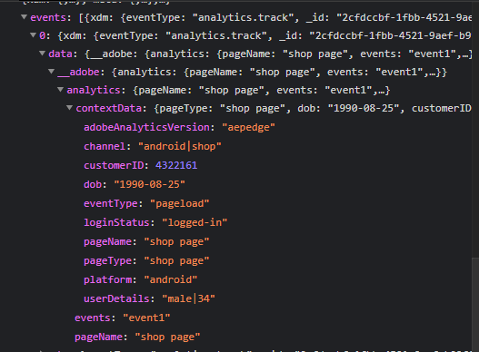
Click Type | Tracking Type | Launch variables | Expected Values
Buttons click | All CTAs | const xdmData = { eventType: 'analytics.track' }; const adobeDatalayer = { __adobe: { analytics: { linkType: 'o’, events: "event2", contextData: { linkName: "<cta name>", channel: "<android/ios>|home", linkPageName: "home page", customerID: "<customerID>", // only pass when available loginStatus: "<logged-in/guest>", platform: "<android/ios>", userDetails: "<gender>|<age>", // only when user is logged in dob: "<date of birth>", // only when user is logged in adobeAnalyticsVersion: "aepedge", eventType: "click" } } } }; let experienceEvent = new ExperienceEvent({ xdmData: xdmData, data: adobeDatalayer }); Edge.sendEvent(experienceEvent); | loginStatus may have the values:- logged-in guest

Slide 38

SLP

Slide 39
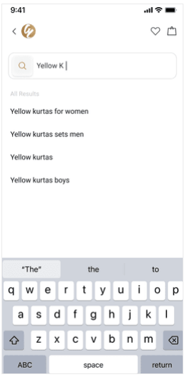
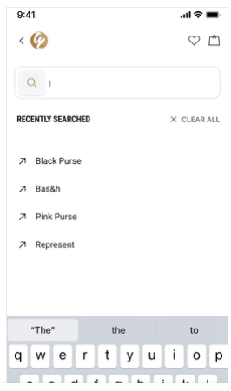
Search bar CTAs or recommended search CTA

Slide 40
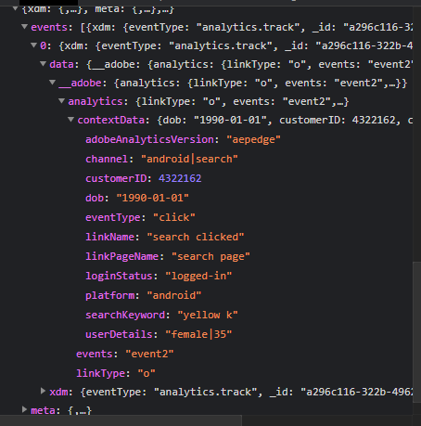
Click Type | Tracking Type | Launch variables | Expected Values
Search bar CTA clicks | All CTAs | const adobeDatalayer = { __adobe: { analytics: { linkType: 'o’, events: "event2", contextData: { linkName: "search clicked", channel: "<android/ios>|<page name without the word 'page'>", // e.g., home, product listing linkPageName: "<page name from where the search was clicked>", customerID: "<customerID>", // only pass when available loginStatus: "<logged-in/guest>", searchKeyword: "<search keyword>", platform: "<android/ios>", userDetails: "<gender>|<age>", // only when user is logged in dob: "<date of birth>", // only when user is logged in adobeAnalyticsVersion: "aepedge", eventType: "click" } } } }; let experienceEvent = new ExperienceEvent({ xdmData: xdmData, data: adobeDatalayer }); Edge.sendEvent(experienceEvent);

Slide 41
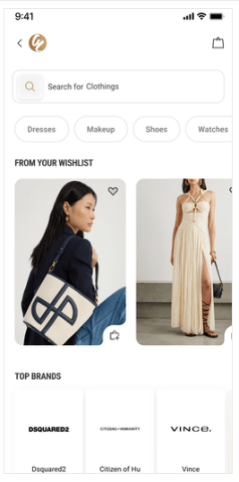
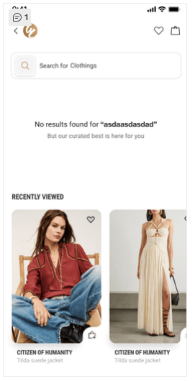
On Load of Search listing page

Slide 42
Page Type | Tracking Type | Launch variables | Expected Values
SLP page | onLoad | const xdmData = { eventType: 'analytics.track' }; const adobeDatalayer = { __adobe: { analytics: { pageName: "product listing page", events: "event1", contextData: { pageName: "product listing page", channel: "<android/ios>|product listing", customerID: "<customerID>", // only pass when available loginStatus: "<logged-in/guest>", pageType: "product listing page", searchKeyword: "<search keyword>", searchType: "<type of the search>", platform: "<android/ios>", plpProductCategory: “<products category>", searchProductCount: "<number of product count>", // total number of products available for the search term userDetails: "<gender>|<age>", // only when user is logged in dob: "<date of birth>", // only when user is logged in adobeAnalyticsVersion: "aepedge", eventType: "pageload" } } } }; let experienceEvent = new ExperienceEvent({ xdmData: xdmData, data: adobeDatalayer }); Edge.sendEvent(experienceEvent); | loginStatus may have the values:- logged-in Guest Search Type will be – Normal Search – In case user have search from the entered keyword. Predictive Search – In case user have selected any recommended keyword during entering keyword Recent Search – Incase user selected any from the provided recent search term list. Trending Search – Incase user selected any from the provided trending search term list. Null Search – When no result available for the searched term.

Slide 43
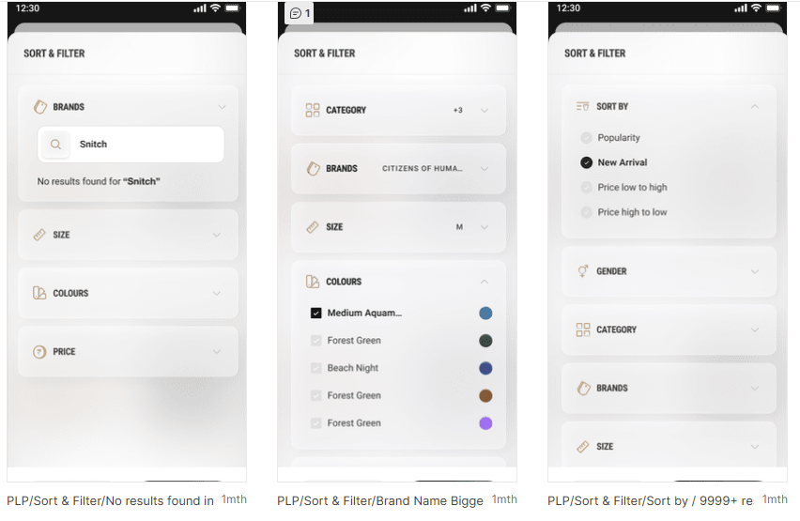
PLP : (Sort & Filter Click)

Slide 44
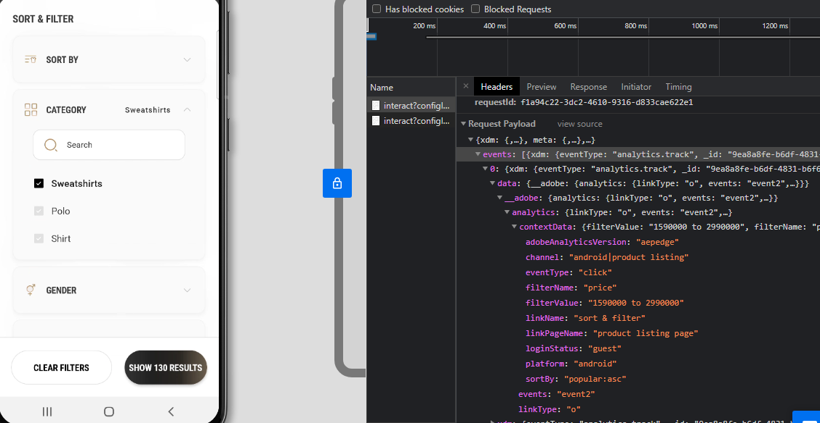
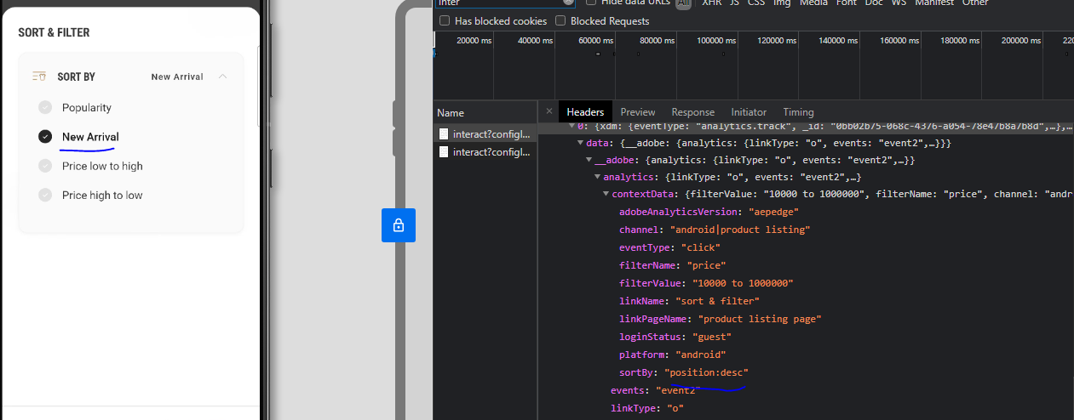
Click Type | Tracking Type | Launch variables | Expected Values
Sort By | dropdown | const xdmData = { eventType: 'analytics.track' }; const adobeDatalayer = { __adobe: { analytics: { linkType: 'o’, events: "event2", contextData: { linkName: "sort & filter", channel: "<android/ios>|product listing", linkPageName: "product listing page", customerID: "<customerID>", // only pass when available loginStatus: "<logged-in/guest>", plpProductCategory: “<products category>", sortBy: "<sort by option>", // only when user has manually sorted filterName: "<filter 1 applied, filter 2 applied, … filter N applied>", // only when filter is applied filterValue: "<filter 1 value, filter 2 value, … filter N value>", // only when filter is applied platform: "<android/ios>", userDetails: "<gender>|<age>", // only when user is logged in dob: "<date of birth>", // only when user is logged in adobeAnalyticsVersion: "aepedge", eventType: "click" } } } }; let experienceEvent = new ExperienceEvent({ xdmData: xdmData, data: adobeDatalayer }); Edge.sendEvent(experienceEvent); | loginStatus may have the values:- logged-in guest In sortBy, expected values are new arrivals price, low to high

Slide 45
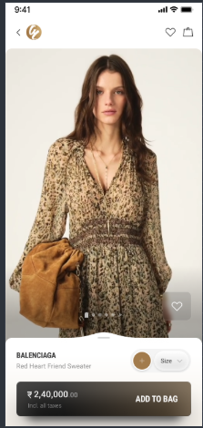
On SLP page, Add to cart click

Slide 46
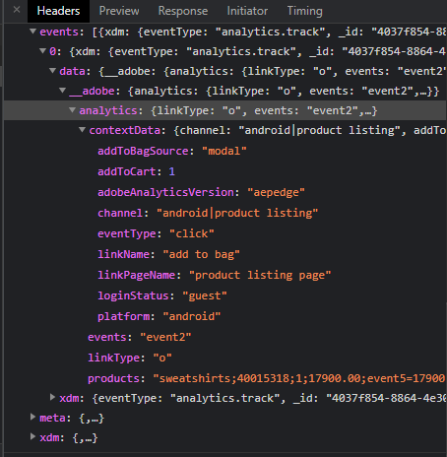
Click Type | Tracking Type | Launch variables | Expected Values
Preview : Add to bag | Button | const xdmData = { eventType: 'analytics.track' }; const adobeDatalayer = { __adobe: { analytics: { linkType: 'o’, events: "event2", // Products syntax with quantity, price, and product-level eVars products: "<product category>;<product ID>;<product quantity>;<product selling price>;event5=<product Selling Price>|event6=<product quantity>|event9=<product discount amount>;eVar32=<product name>|eVar33=<product category>|eVar34=<product color>|eVar35=<product size>|eVar37=<product stock status>“, contextData: { linkName: "add to bag", channel: "<android/ios>|product listing", linkPageName: "product listing page", addToCart: 1, // only pass when product is added to cart customerID: "<customerID>", // only pass when available loginStatus: "<logged-in/guest>", addToBagSource: "<page name or modal name from where product was added>", platform: "<android/ios>", userDetails: "<gender>|<age>", // only when user is logged in dob: "<date of birth>", // only when user is logged in adobeAnalyticsVersion: "aepedge", eventType: "click" } } } }; let experienceEvent = new ExperienceEvent({ xdmData: xdmData, data: adobeDatalayer }); Edge.sendEvent(experienceEvent); | loginStatus may have the values:- logged-in guest productID: will have the value of SKU ID of the product. productCategory: will have the category of the product. productSellPrice: will contain the actual selling price of the product. productQuantity: will have the quantity selected for the product. productName: name of the product. stockStatus: it will show the quantity of the product available in the stock. color: example values: Red. size: example values:- 42 L productDiscount will have the discount applied on the product. In the products variable, the following product attributes should be mapped to their respective Adobe Analytics merchandising eVars and events: productID → Standard placement (second position in the products string) productCategory → eVar33,1st position in the product string productSellPrice → event5 productQuantity → event6 productName → eVar32 stockStatus → eVar37 color → eVar34 size → eVar35 productDiscount → event9 These mappings should be included in the products string using the Adobe Analytics format: Example syntax for Products: (comma separator used for multiple products passing in the below format: products = "<category>;<productID>;<quantity>;<base productprice>;event5=1|event6=<quantity>|event9=<discount>;eVar32=<name>|eVar33=<category>|eVar34=<color>|eVar35=<size>|eVar37=<stock status>" 📌 Adobe products Syntax – Quantity & Price Guidance for Mobile Developers: When using the Adobe products string in AEP Mobile SDK, do not manually calculate and pass the total price (i.e., quantity × price). Adobe Analytics automatically performs this calculation based on the values you provide. ✅ Correct Usage: 3rd position → Quantity 4th position → Base price (unit price of a single product) Example: If a user adds 2 units of a product priced at 100 USD each, use: Adobe will automatically compute the total revenue as 200 USD. ✅ Summary: Always pass actual quantity and base price. Let Adobe handle the total price calculation. This ensures accurate reporting and avoids data inconsistencies.

Slide 47
PLP

Slide 48

On Load of Product listing page

Slide 49

Page Type | Tracking Type | Launch variables | Expected Values
PLP page | onLoad | const xdmData = {'eventType': 'analytics.track'}; const adobeDatalayer = { __adobe:{ analytics:{ pageName: "product listing page", events: “event1”, contextData:{ pageName: "product listing page", channel: "<android/ios>|product listing", customerID : "<customerID>", // only pass when available loginStatus : "<logged-in/guest>" , pageType : "product listing page" platform: "<android/ios>", plpProductCategory : “<products category>”, productCount:“<number of product count>“, userDetails: "<gender>|<age>", // pass only when user has logged in dob: "<date of birth>" // pass only when user has logged in adobeAnalyticsVersion: “aepedge”, eventType: 'pageload' } } } }; let experienceEvent = new ExperienceEvent({ xdmData: xdmData, data: adobeDatalayer }); Edge.sendEvent(experienceEvent) | loginStatus may have the values:- logged-in guest

Slide 50
On PLP page, Add to cart click

Slide 51

Click Type | Tracking Type | Launch variables | Expected Values
Preview : Add to bag | Button | const xdmData = {'eventType': 'analytics.track'}; const adobeDatalayer = { __adobe:{ analytics:{ linkType: ‘o’, events: "event2", // Products syntax with quantity, price, and product-level eVars products: "<product category>;<product ID>;<product quantity>;<product selling price>;event5=<product Selling Price>|event6=<product quantity>|event9=<product discount amount>|eVar32=<product name>|eVar33=<product category>|eVar34=<product color>|eVar35=<product size>|eVar37=<product stock status>|eVar41=<brand of the product>”, contextData:{ linkName: “add to bag", channel: "<android/ios>|product listing", linkPageName: ”product listing page", addToCart: 1, //1 will be passed as an integer value only when user has added a product into the cart customerID : "<customerID>", // only pass when available loginStatus : "<logged-in/guest>" , addToBagSource: “<page name or modal name from where product was added”>, platform: ”<android/ios>", userDetails: "<gender>|<age>", // pass only when user is logged in dob: "<date of birth>" // pass only when user is logged in adobeAnalyticsVersion: “aepedge”, eventType: 'click' } } } }; let experienceEvent = new ExperienceEvent({ xdmData: xdmData, data: adobeDatalayer }); Edge.sendEvent(experienceEvent) | loginStatus may have the values:- logged-in guest productID: will have the value of SKU ID of the product. productCategory: will have the category of the product. productSellPrice: will contain the actual selling price of the product. productQuantity: will have the quantity selected for the product. productName: name of the product. stockStatus: it will show the quantity of the product available in the stock. color: example values: Red. size: example values:- 42 L productDiscount will have the discount applied on the product.

Slide 52


PLP : (Sort & Filter Click)

Slide 53

Click Type | Tracking Type | Launch variables | Expected Values
Sort By and Filter | dropdown | const xdmData = { eventType: 'analytics.track' }; const adobeDatalayer = { __adobe: { analytics: { linkType: 'o’, events: "event2", contextData: { linkName: "sort & filter", channel: "<android/ios>|product listing", linkPageName: "product listing page", customerID: "<customerID>", // only pass when available loginStatus: "<logged-in/guest>", plpProductCategory: "products category", sortBy: "<sort by option>", // only when user has manually sorted filterName: "<filter 1 applied, filter 2 applied, … filter N applied>", // only when filter is applied filterValue: "<filter 1 value, filter 2 value, … filter N value>", // only when filter is applied platform: "<android/ios>", userDetails: "<gender>|<age>", // only when user is logged in dob: "<date of birth>", // only when user is logged in adobeAnalyticsVersion: "aepedge", eventType: "click" } } } }; let experienceEvent = new ExperienceEvent({ xdmData: xdmData, data: adobeDatalayer }); Edge.sendEvent(experienceEvent); | loginStatus may have the values:- logged-in guest In sortBy, expected values are new arrivals price, low to high

Slide 54
PDP

Slide 55

On PDP load

Slide 56

Page Type | Tracking Type | Launch variables | Expected Values
Product page | onload | const xdmData = {'eventType': 'analytics.track'}; const adobeDatalayer = { __adobe:{ analytics:{ pageName: "product page", events: “event1”, products: "<product category>;<product ID>;;<product selling price>;event5=<product Selling Price>|event9=<product discount amount>|eVar32=<product name>|eVar33=<product category>|eVar41=<brand of the product>”, contextData:{ pageName: "product page", channel: "<android/ios>|product", customerID : "<customerID>", // only pass when available loginStatus : "<logged-in/guest>", pageType : "product page", platform: "<android/ios>", userDetails: "<gender>|<age>", // pass only when user has logged in dob: "<date of birth>“, // pass only when user has logged in adobeAnalyticsVersion: “aepedge”, eventType: 'pageload' } } } }; let experienceEvent = new ExperienceEvent({ xdmData: xdmData, data: adobeDatalayer }); Edge.sendEvent(experienceEvent) | loginStatus may have the values:- logged-in guest productID: will have the value of SKU ID of the product. productCategory: will have the category of the product. productSellPrice: will contain the actual selling price of the product. productName: name of the product.

Slide 57

On clicking on Add to bag

Slide 58

Click Type | Tracking Type | Launch variables | Expected Values
Buy now/ Add to bag | Button | const xdmData = {'eventType': 'analytics.track'}; const adobeDatalayer = { __adobe:{ analytics:{ linkType: ‘o’, events: "event2", // Products syntax with quantity, price, and product-level eVars products: "<product category>;<product ID>;<product quantity>;<product selling price>;event5=<product Selling Price>|event6=<product quantity>|event9=<product discount amount>|eVar32=<product name>|eVar33=<product category>|eVar34=<product color>|eVar35=<product size>|eVar37=<product stock status>|eVar41=<brand of the product>”, contextData:{ linkName: “add to bag", channel: "<android/ios>|product", linkPageName: ”product page", addToCart: 1, //1 will be passed as an integer value only when user has added a product into the cart customerID : "<customerID>", // only pass when available loginStatus : "<logged-in/guest>" , addToBagSource: “<page name or modal name from where product was added”>, platform: "<android/ios>", userDetails: "<gender>|<age>", // pass only when user is logged in dob: "<date of birth>“, // pass only when user is logged in adobeAnalyticsVersion: “aepedge”, eventType: 'click' } } } }; let experienceEvent = new ExperienceEvent({ xdmData: xdmData, data: adobeDatalayer }); Edge.sendEvent(experienceEvent) | loginStatus may have the values:- logged-in guest productID: will have the value of SKU ID of the product. productCategory: will have the category of the product. productMarkPrice: will contain the MRP of the product. productSellPrice: will contain the actual selling price of the product. productQuantity: will have the quantity selected for the product. productName: name of the product. brandName: name of the brand of the product. stockStatus: it will show the quantity of the product available in the stock. color: example values: Red. size: example values:- 42 L productDiscount will have the discount applied on the product.

Slide 59

All CTA clicks(except add to bag and add to wishlist)

Slide 60
Click Type | Tracking Type | Launch variables | Expected Values
Product page clicks | All CTAs | const xdmData = {'eventType': 'analytics.track'}; const adobeDatalayer = { __adobe:{ analytics:{ linkType: ‘o’, events: "event2", contextData:{ linkName: "<cta name>", channel: "<android/ios>|product", linkPageName: "product page", customerID : "<customerID>", // only pass when available loginStatus : "<logged-in/guest>" , platform: "<android/ios>", userDetails: "<gender>|<age>", // pass only when user is logged in dob: "<date of birth>" // pass only when user is logged in adobeAnalyticsVersion: “aepedge”, eventType: 'click' } } } }; let experienceEvent = new ExperienceEvent({ xdmData: xdmData, data: adobeDatalayer }); Edge.sendEvent(experienceEvent) | loginStatus may have the values:- logged-in guest // no call should be passed on Product zoom or product images

Slide 61

On Notify Popup load

Slide 62
Page Type | Tracking Type | Launch variables | Expected Values
Get Notified Modal | onView | const xdmData = {'eventType': 'analytics.track'}; const adobeDatalayer = { __adobe:{ analytics:{ pageName: "get notified", events: “event1”, contextData:{ pageName: ”get notified", channel: "<android/ios>|product", parentPage : “product page”, customerID : "<customerID>", // only pass when available loginStatus : "<logged-in/guest>", pageType : ”get notified", platform: "<android/ios>", userDetails: "<gender>|<age>", // pass only when user has logged in dob: "<date of birth>“, // pass only when user has logged in adobeAnalyticsVersion: “aepedge”, eventType: 'pageload' } } } }; let experienceEvent = new ExperienceEvent({ xdmData: xdmData, data: adobeDatalayer }); Edge.sendEvent(experienceEvent) | loginStatus may have the values:- logged-in guest productID: will have the value of SKU ID of the product. productCategory: will have the category of the product. productSellPrice: will contain the actual selling price of the product. productName: name of the product.

Slide 63
Get Notified Modal - Clicks

Slide 64
Click Type | Tracking Type | Launch variables | Expected Values
Get Notified Clicks | All CTAs | const xdmData = {'eventType': 'analytics.track'}; const adobeDatalayer = { __adobe:{ analytics:{ linkType: ‘o’, events: "event2", contextData:{ linkName: "<cta name>", channel: "<android/ios>|product", linkPageName: "get notified", customerID : "<customerID>", // only pass when available loginStatus : "<logged-in/guest>" , platform: "<android/ios>", userDetails: "<gender>|<age>", // pass only when user is logged in dob: "<date of birth>“, // pass only when user is logged in adobeAnalyticsVersion: “aepedge”, eventType: 'click' } } } }; let experienceEvent = new ExperienceEvent({ xdmData: xdmData, data: adobeDatalayer }); Edge.sendEvent(experienceEvent) | loginStatus may have the values:- logged-in guest // no call should be passed on Product zoom or product images

Slide 65
Cart to Success

Slide 66

On cart page load

Slide 67
Page Type | Tracking Type | Launch variables | Expected Values
Cart page | onLoad | const xdmData = { eventType: 'analytics.track' }; const adobeDatalayer = { __adobe: { analytics: { pageName: "cart page",​ events: "event1", products: "<product category>;<product ID>;<product quantity>;<product base price>;event5=<product base Price>|event6=<product quantity>|event9=<product discount amount>;eVar32=<product name>|eVar33=<product category>|eVar34=<product color>|eVar35=<product size>|eVar37=<product stock status>|eVar41=<product brand>|eVar46=<product as Gift Status>," contextData: { channel: "<android/ios>|cart", pageName: "cart page", numberOfProducts: "<number of total Products available in the cart>", customerID: "<customerID>", // only pass when available loginStatus: "<logged-in/guest>", pageType: "cart page", platform: "<android/ios>", userDetails: "<gender>|<age>", // only when user is logged in dob: "<date of birth>", // only when user is logged in adobeAnalyticsVersion: "aepedge", eventType: "pageload" } } } }; let experienceEvent = new ExperienceEvent({ xdmData: xdmData, data: adobeDatalayer }); Edge.sendEvent(experienceEvent); | loginStatus may have the values:- logged-in guest productID: will have the value of SKU ID of the product. productCategory: will have the category of the product. productSellPrice: will contain the actual selling price of the product. productName: name of the product. stockStatus: it will show the quantity of the product available in the stock. color: example values: Red. size: example values:- 42 L productDiscount will have the discount applied on the product. productAsGift: “yes,no,…yes”, by default it will be “no”.

Slide 68

On click of product remove

Slide 69
Click Type | Tracking Type | Launch variables | Expected Values
Product Remove | Button | const xdmData = { eventType: 'analytics.track' }; const adobeDatalayer = { __adobe: { analytics: { linkType: 'o', events: "event2", // Products syntax with quantity, price, and product-level eVars products: "<product category>;<product ID>;<product quantity>;<product selling price>;event5=<product Selling Price>|event6=<product quantity>|event9=<product discount amount>; eVar32=<product name>|eVar33=<product category>|eVar34=<product color>|eVar35=<product size>|eVar37=<product stock status>|eVar41=<product brand>|eVar46=<product as Gift Status>“, contextData: { linkName: "remove product", linkPageName: "cart page", removefromcart: 1, // only pass when product is removed channel: "<android/ios>|cart", customerID: "<customerID>", // only pass when available loginStatus: "<logged-in/guest>", platform: "<android/ios>", userDetails: "<gender>|<age>", // only when user is logged in dob: "<date of birth>", // only when user is logged in adobeAnalyticsVersion: "aepedge", eventType: "click" } } } }; let experienceEvent = new ExperienceEvent({ xdmData: xdmData, data: adobeDatalayer }); Edge.sendEvent(experienceEvent); | loginStatus may have the values:- logged-in guest productID: will have the value of SKU ID of the product. productCategory: will have the category of the product. productMarkPrice: will contain the MRP of the product. productSellPrice: will contain the actual selling price of the product. productQuantity: will have the quantity selected for the product. productName: name of the product. brandName: name of the brand of the product. stockStatus: it will show the quantity of the product available in the stock. color: example values: Red. size: example values:- 42 L productDiscount will have the discount applied on the product. productAsGift: “yes,no,…yes”, by default it will be “no”.

Slide 70

On click of move to wishlist

Slide 71
Click Type | Tracking Type | Launch variables | Expected Values
Add to wishlist | Icon | const xdmData = { eventType: 'analytics.track' }; const adobeDatalayer = { __adobe: { analytics: { linkType: 'o', events: "event2", // Products syntax with quantity, price, and product-level eVars products: "<product category>;<product ID>;<product quantity>;<product selling price>;;eVar32=<product name>|eVar33=<product category>|eVar41=<product brand>“, contextData: { linkName: "<add to wishlist/remove from wishlist>", linkPageName: “cart page", wishlistAdded: 1, // Only pass when product is added to wishlist channel: "<android/ios>|<page name without the word 'page'>", // e.g., home, category customerID: "<customerID>", // Only pass when available loginStatus: "<logged-in/guest>", platform: "<android/ios>", userDetails: "<gender>|<age>", // Only when user is logged in dob: "<date of birth>", // Only when user is logged in adobeAnalyticsVersion: "aepedge", eventType: "click" } } } }; let experienceEvent = new ExperienceEvent({ xdmData: xdmData, data: adobeDatalayer }); Edge.sendEvent(experienceEvent); | loginStatus may have the values:- logged-in guest productID: will have the value of SKU ID of the product. productCategory: will have the category of the product. productName: name of the product.

Slide 72

On successful response for quantity update

Slide 73
Click Type | Tracking Type | Launch variables | Expected Values
Product Increment​/decrement | dropdown button​ | const xdmData = { eventType: 'analytics.track' }; const adobeDatalayer = { __adobe: { analytics: { linkType: 'o', events: "event2", // Products syntax with quantity, price, and product-level eVars products: "<product category>;<product ID>;<product quantity>;<product selling price>;event5=<product Selling Price>|event6=<product quantity>|event9=<product discount amount>; eVar32=<product name>|eVar33=<product category>|eVar34=<product color>|eVar35=<product size>|eVar37=<product stock status>|eVar41=<product brand>|eVar46=<product as Gift Status>“, contextData: { linkName: :“<product quantity increased/product quantity decreased>",​ linkPageName: "cart page", channel: "<android/ios>|cart", customerID: "<customerID>", // only pass when available loginStatus: "<logged-in/guest>", platform: "<android/ios>", userDetails: "<gender>|<age>", // only when user is logged in dob: "<date of birth>", // only when user is logged in adobeAnalyticsVersion: "aepedge", eventType: "click" } } } }; let experienceEvent = new ExperienceEvent({ xdmData: xdmData, data: adobeDatalayer }); Edge.sendEvent(experienceEvent); | loginStatus may have the values:- logged-in guest

Slide 74

On send as gift click

Slide 75
Click Type | Tracking Type | Launch variables | Expected Values
Send as gift | CTA button | const xdmData = { eventType: 'analytics.track' }; const adobeDatalayer = { __adobe: { analytics: { linkType: 'o', events: "event2", contextData: { linkName: :“send as gift",​ linkPageName: “cart page", channel: "<android/ios>|cart", customerID: "<customerID>", // only pass when available loginStatus: "<logged-in/guest>", platform: "<android/ios>", userDetails: "<gender>|<age>", // only when user is logged in dob: "<date of birth>", // only when user is logged in adobeAnalyticsVersion: "aepedge", eventType: "click" } } } }; let experienceEvent = new ExperienceEvent({ xdmData: xdmData, data: adobeDatalayer }); Edge.sendEvent(experienceEvent); | loginStatus may have the values:- logged-in guest

Slide 76

On send as gift view

Slide 77
Page Type | Tracking Type | Launch variables | Expected Values
Select item as gift modal | onView | const adobeDatalayer = { __adobe: { analytics: { pageName: "select item as gift", events: "event1", contextData: { pageName: "select item as gift", channel: "<android/ios>|cart", parentPage: "cart page", customerID: "<customerID>", // only pass when available loginStatus: "<logged-in/guest>", pageType: "select item as gift", platform: "<android/ios>", userDetails: "<gender>|<age>", // only when user is logged in dob: "<date of birth>", // only when user is logged in adobeAnalyticsVersion: "aepedge", eventType: "pageload" } } } }; let experienceEvent = new ExperienceEvent({ xdmData: xdmData, data: adobeDatalayer }); Edge.sendEvent(experienceEvent); | loginStatus may have the values:- logged-in guest productID: will have the value of SKU ID of the product. productCategory: will have the category of the product. productSellPrice: will contain the actual selling price of the product. productName: name of the product.

Slide 78

Select send as gift CTA

Slide 79
Click Type | Tracking Type | Launch variables | Expected Values
Multiple clicks | CTA button | const xdmData = { eventType: 'analytics.track' }; const adobeDatalayer = { __adobe: { analytics: { linkType: 'o', events: "event2", // Products syntax with quantity, price, and product-level eVars products: "<product category>;<product ID>;<product quantity>;<product selling price>;event5=<product Selling Price>|event6=<product quantity>|event9=<product discount amount>; eVar32=<product name>|eVar33=<product category>|eVar34=<product color>|eVar35=<product size>|eVar37=<product stock status>|eVar41=<product brand>|eVar46=<product as Gift Status>“, contextData: { linkName: :“<cta name>",​ linkPageName: "cart page", channel: "<android/ios>|cart", customerID: "<customerID>", // only pass when available loginStatus: "<logged-in/guest>", platform: "<android/ios>", userDetails: "<gender>|<age>", // only when user is logged in dob: "<date of birth>", // only when user is logged in adobeAnalyticsVersion: "aepedge", eventType: "click" } } } }; let experienceEvent = new ExperienceEvent({ xdmData: xdmData, data: adobeDatalayer }); Edge.sendEvent(experienceEvent); ​ | loginStatus may have the values:- logged-in guest

Slide 80

On gift wrap view

Slide 81
Page Type | Tracking Type | Launch variables | Expected Values
Wrap your Gift | onView | const adobeDatalayer = { __adobe: { analytics: { pageName: "wrap your gift", events: "event1", contextData: { pageName: "wrap your gift", channel: "<android/ios>|cart", parentPage: "cart page", customerID: "<customerID>", // only pass when available loginStatus: "<logged-in/guest>", pageType: "wrap your gift", platform: "<android/ios>", userDetails: "<gender>|<age>", // only when user is logged in dob: "<date of birth>", // only when user is logged in adobeAnalyticsVersion: "aepedge", eventType: "pageload" } } } }; let experienceEvent = new ExperienceEvent({ xdmData: xdmData, data: adobeDatalayer }); Edge.sendEvent(experienceEvent); | loginStatus may have the values:- logged-in guest productID: will have the value of SKU ID of the product. productCategory: will have the category of the product. productSellPrice: will contain the actual selling price of the product. productName: name of the product.

Slide 82

On Continue Click

Slide 83
Click Type | Tracking Type | Launch variables | Expected Values
Continue CTA | CTA button | diconst xdmData = { eventType: 'analytics.track' }; const adobeDatalayer = { __adobe: { analytics: { linkType: 'o', events: "event2", contextData: { linkName: :“<cta name>",​ linkPageName: "cart page", channel: "<android/ios>|cart", customerID: "<customerID>", // only pass when available loginStatus: "<logged-in/guest>", platform: "<android/ios>", userDetails: "<gender>|<age>", // only when user is logged in dob: "<date of birth>", // only when user is logged in adobeAnalyticsVersion: "aepedge", eventType: "click" } } } }; let experienceEvent = new ExperienceEvent({ xdmData: xdmData, data: adobeDatalayer }); Edge.sendEvent(experienceEvent); | loginStatus may have the values:- logged-in guest

Slide 84

On Confirm Gifting Click

Slide 85
Click Type | Tracking Type | Launch variables | Expected Values
confirm gifting | CTA button | const xdmData = { eventType: 'analytics.track' }; const adobeDatalayer = { __adobe: { analytics: { linkType: 'o', events: "event2", // Multiple Products can be passed using comma(,) as a separator highlighted below for second product// products: "<product category1>;<product ID1>;<product quantity1>;<product selling price1>;event5=<product Selling Price1>|event6=<product quantity1>|event9=<product discount amount1>|event34=<product 1coupon discount>;eVar32=<product 1 name>|eVar33=<product category1>|eVar34=<product color1>|eVar35=<product size1>|eVar37=<product stock status1>|eVar39=<product position1>|eVar41=<product brand1>|eVar46=<product as Gift Status1>, <product category2>;<product ID2>;<product quantity2>;<product selling price2>;event5=<product Selling Price2>|event6=<product quantity2>|event9=<product discount amount2>|event34=<product 1coupon discount>;eVar32=<product 1 name>|eVar33=<product category2>|eVar34=<product color2>|eVar35=<product size2>|eVar37=<product stock status2>|eVar39=<product position1>|eVar41=<product brand2>|eVar46=<product as Gift Status2,…..etc..n-products..” contextData: { linkName: :“<cta name>",​ linkPageName: "cart page", channel: "<android/ios>|cart", customerID: "<customerID>", // only pass when available loginStatus: "<logged-in/guest>", platform: "<android/ios>", userDetails: "<gender>|<age>", // only when user is logged in dob: "<date of birth>", // only when user is logged in adobeAnalyticsVersion: "aepedge", eventType: "click" } } } }; let experienceEvent = new ExperienceEvent({ xdmData: xdmData, data: adobeDatalayer }); Edge.sendEvent(experienceEvent); | loginStatus may have the values:- logged-in guest

Slide 86

On review gifting view

Slide 87
Page Type | Tracking Type | Launch variables | Expected Values
Review gifting | onView | const adobeDatalayer = { __adobe: { analytics: { pageName: "review gifting", events: "event1", contextData: { pageName: “review gifting", channel: "<android/ios>|cart", parentPage: "cart page", customerID: "<customerID>", // only pass when available loginStatus: "<logged-in/guest>", pageType: "review gifting", platform: "<android/ios>", userDetails: "<gender>|<age>", // only when user is logged in dob: "<date of birth>", // only when user is logged in adobeAnalyticsVersion: "aepedge", eventType: "pageload" } } } }; let experienceEvent = new ExperienceEvent({ xdmData: xdmData, data: adobeDatalayer }); Edge.sendEvent(experienceEvent); | loginStatus may have the values:- logged-in guest productID: will have the value of SKU ID of the product. productCategory: will have the category of the product. productSellPrice: will contain the actual selling price of the product. productName: name of the product.

Slide 88

On CTA clicks

Slide 89
Click Type | Tracking Type | Launch variables | Expected Values
Multiple clicks | CTA button | const xdmData = { eventType: 'analytics.track' }; const adobeDatalayer = { __adobe: { analytics: { linkType: 'o', events: "event2", // Multiple Products can be passed using comma(,) as a separator highlighted below for second product// products: "<product category1>;<product ID1>;<product quantity1>;<product selling price1>;event5=<product Selling Price1>|event6=<product quantity1>|event9=<product discount amount1>|event34=<product 1coupon discount>;eVar32=<product 1 name>|eVar33=<product category1>|eVar34=<product color1>|eVar35=<product size1>|eVar37=<product stock status1>|eVar39=<product position1>|eVar41=<product brand1>|eVar46=<product as Gift Status1>, <product category2>;<product ID2>;<product quantity2>;<product selling price2>;event5=<product Selling Price2>|event6=<product quantity2>|event9=<product discount amount2>|event34=<product 1coupon discount>;eVar32=<product 1 name>|eVar33=<product category2>|eVar34=<product color2>|eVar35=<product size2>|eVar37=<product stock status2>|eVar39=<product position1>|eVar41=<product brand2>|eVar46=<product as Gift Status2,…..etc..n-products..” contextData: { linkName: “<cta name>",​ linkPageName: "cart page", channel: "<android/ios>|cart", customerID: "<customerID>", // only pass when available loginStatus: "<logged-in/guest>", platform: "<android/ios>", userDetails: "<gender>|<age>", // only when user is logged in dob: "<date of birth>", // only when user is logged in adobeAnalyticsVersion: "aepedge", eventType: "click" } } } }; let experienceEvent = new ExperienceEvent({ xdmData: xdmData, data: adobeDatalayer }); Edge.sendEvent(experienceEvent); | loginStatus may have the values:- logged-in guest

Slide 90


On click of Apply/Remove code

Slide 91
Click Type | Tracking Type | Launch variables | Expected Values
Coupon Apply/Remove | button | const xdmData = { eventType: 'analytics.track' }; const adobeDatalayer = { __adobe: { analytics: { linkType: 'o', events: "event2", contextData: { linkName: :“<coupon apply/remove coupon>",​ appliedCouponCode: "<coupon code>-<offer value>”, // only when coupon is applied removedCouponcode:"<coupon code>-<offer value>”, // only when coupon is removed linkPageName: "cart page", channel: "<android/ios>|cart", customerID: "<customerID>", // only pass when available loginStatus: "<logged-in/guest>", platform: "<android/ios>", userDetails: "<gender>|<age>", // only when user is logged in dob: "<date of birth>", // only when user is logged in adobeAnalyticsVersion: "aepedge", eventType: "click" } } } }; let experienceEvent = new ExperienceEvent({ xdmData: xdmData, data: adobeDatalayer }); Edge.sendEvent(experienceEvent); | loginStatus may have the values:- logged-in Guest appliedCouponCode: If a coupon is applied as per below example:-​ If coupon code is Welcome500, Additional 10% off, which save Rs 1500 on the order value. appliedCouponCode: “Welcome500-1500"

Slide 92

On click of checkout

Slide 93
Click Type | Tracking Type | Launch variables | Expected Values
Proceed to checkout | Button | const xdmData = { eventType: 'analytics.track' }; const adobeDatalayer = { __adobe: { analytics: { linkType: 'o', events: "event2", // Multiple Products can be passed using comma(,) as a separator highlighted below for second product// products: "<product category1>;<product ID1>;<product quantity1>;<product selling price1>;event5=<product Selling Price1>|event6=<product quantity1>|event9=<product discount amount1>|event34=<product 1coupon discount>;eVar32=<product 1 name>|eVar33=<product category1>|eVar34=<product color1>|eVar35=<product size1>|eVar37=<product stock status1>|eVar39=<product position1>|eVar41=<product brand1>|eVar46=<product as Gift Status1>, <product category2>;<product ID2>;<product quantity2>;<product selling price2>;event5=<product Selling Price2>|event6=<product quantity2>|event9=<product discount amount2>|event34=<product 1coupon discount>;eVar32=<product 1 name>|eVar33=<product category2>|eVar34=<product color2>|eVar35=<product size2>|eVar37=<product stock status2>|eVar39=<product position1>|eVar41=<product brand2>|eVar46=<product as Gift Status2,…..etc..n-products..” contextData: { linkName: “proceed to checkout", linkPageName: "cart page", numberOfProducts: "<number of total Products available in the cart>", channel: "<android/ios>|cart", customerID: "<customerID>", // only pass when available loginStatus: "<logged-in/guest>", platform: "<android/ios>", userDetails: "<gender>|<age>", // only when user is logged in dob: "<date of birth>", // only when user is logged in adobeAnalyticsVersion: "aepedge", eventType: "click" } } } }; let experienceEvent = new ExperienceEvent({ xdmData: xdmData, data: adobeDatalayer }); Edge.sendEvent(experienceEvent); | loginStatus may have the values:- logged-in guest productID: will have the value of SKU ID of the product. productCategory: will have the category of the product. productMarkPrice: will contain the MRP of the product. productSellPrice: will contain the actual selling price of the product. productQuantity: will have the quantity selected for the product. productName: name of the product. brandName: name of the brand of the product. stockStatus: it will show the quantity of the product available in the stock. color: example values: Red. size: example values:- 42 L productDiscount will have the discount applied on the product. productAsGift: “yes,no,…yes”, by default it will be “no”.

Slide 94

Delivery Page

Slide 95
Page Type | Tracking Type | Launch variables | Expected Values
Delivery page | onLoad | const xdmData = { eventType: 'analytics.track' }; const adobeDatalayer = { __adobe: { analytics: { pageName: ”delivery page",​ events: "event1", // Multiple Products can be passed using comma(,) as a separator highlighted below for second product// products: "<product category1>;<product ID1>;<product quantity1>;<product selling price1>;event5=<product Selling Price1>|event6=<product quantity1>|event9=<product discount amount1>|event34=<product 1coupon discount>;eVar32=<product 1 name>|eVar33=<product category1>|eVar34=<product color1>|eVar35=<product size1>|eVar37=<product stock status1>|eVar39=<product position1>|eVar41=<product brand1>|eVar46=<product as Gift Status1>, <product category2>;<product ID2>;<product quantity2>;<product selling price2>;event5=<product Selling Price2>|event6=<product quantity2>|event9=<product discount amount2>|event34=<product 1coupon discount>;eVar32=<product 1 name>|eVar33=<product category2>|eVar34=<product color2>|eVar35=<product size2>|eVar37=<product stock status2>|eVar39=<product position1>|eVar41=<product brand2>|eVar46=<product as Gift Status2,…..etc..n-products..” contextData: { pageName: ”delivery page",​ pageType: ”delivery page",​ channel: "<android/ios>|cart", customerID: "<customerID>", // only pass when available loginStatus: "<logged-in/guest>", platform: "<android/ios>", userDetails: "<gender>|<age>", // only when user is logged in dob: "<date of birth>", // only when user is logged in adobeAnalyticsVersion: "aepedge", eventType: "click" } } } }; let experienceEvent = new ExperienceEvent({ xdmData: xdmData, data: adobeDatalayer }); Edge.sendEvent(experienceEvent); | loginStatus may have the values:- logged-in guest productID: will have the value of SKU ID of the product. productCategory: will have the category of the product. productSellPrice: will contain the actual selling price of the product. productName: name of the product. stockStatus: it will show the quantity of the product available in the stock. color: example values: Red. size: example values:- 42 L productDiscount will have the discount applied on the product. productAsGift: “yes,no,…yes”, by default it will be “no”.

Slide 96

Select Address Load

Slide 97
Page Type | Tracking Type | Launch variables | Expected Values
Select Address | onLoad | const xdmData = { eventType: 'analytics.track' }; const adobeDatalayer = { __adobe: { analytics: { pageName: ”select address",​ events: "event1", // Multiple Products can be passed using comma(,) as a separator highlighted below for second product// products: "<product category1>;<product ID1>;<product quantity1>;<product selling price1>;event5=<product Selling Price1>|event6=<product quantity1>|event9=<product discount amount1>|event34=<product 1coupon discount>;eVar32=<product 1 name>|eVar33=<product category1>|eVar34=<product color1>|eVar35=<product size1>|eVar37=<product stock status1>|eVar39=<product position1>|eVar41=<product brand1>|eVar46=<product as Gift Status1>, <product category2>;<product ID2>;<product quantity2>;<product selling price2>;event5=<product Selling Price2>|event6=<product quantity2>|event9=<product discount amount2>|event34=<product 1coupon discount>;eVar32=<product 1 name>|eVar33=<product category2>|eVar34=<product color2>|eVar35=<product size2>|eVar37=<product stock status2>|eVar39=<product position1>|eVar41=<product brand2>|eVar46=<product as Gift Status2,…..etc..n-products..” contextData: { pageName: ”select address",​ parentPage:”delivery page”, pageType: ”select address",​ channel: "<android/ios>|cart", customerID: "<customerID>", // only pass when available loginStatus: "<logged-in/guest>", platform: "<android/ios>", userDetails: "<gender>|<age>", // only when user is logged in dob: "<date of birth>", // only when user is logged in adobeAnalyticsVersion: "aepedge", eventType: "click" } } } }; let experienceEvent = new ExperienceEvent({ xdmData: xdmData, data: adobeDatalayer }); Edge.sendEvent(experienceEvent); | loginStatus may have the values:- logged-in guest

Slide 98

Delivery Here CTA

Slide 99
Click Type | Tracking Type | Launch variables | Expected Values
Deliver Here | button | const xdmData = { eventType: 'analytics.track' }; const adobeDatalayer = { __adobe: { analytics: { linkType: 'o', events: "event2", // Multiple Products can be passed using comma(,) as a separator highlighted below for second product// products: "<product category1>;<product ID1>;<product quantity1>;<product selling price1>;event5=<product Selling Price1>|event6=<product quantity1>|event9=<product discount amount1>|event34=<product 1coupon discount>;eVar32=<product 1 name>|eVar33=<product category1>|eVar34=<product color1>|eVar35=<product size1>|eVar37=<product stock status1>|eVar39=<product position1>|eVar41=<product brand1>|eVar46=<product as Gift Status1>, <product category2>;<product ID2>;<product quantity2>;<product selling price2>;event5=<product Selling Price2>|event6=<product quantity2>|event9=<product discount amount2>|event34=<product 1coupon discount>;eVar32=<product 1 name>|eVar33=<product category2>|eVar34=<product color2>|eVar35=<product size2>|eVar37=<product stock status2>|eVar39=<product position1>|eVar41=<product brand2>|eVar46=<product as Gift Status2,…..etc..n-products..” contextData: { linkName: “deliver here", linkPageName: “select address", channel: "<android/ios>|cart", customerID: "<customerID>", // only pass when available loginStatus: "<logged-in/guest>", platform: "<android/ios>", userDetails: "<gender>|<age>", // only when user is logged in dob: "<date of birth>", // only when user is logged in adobeAnalyticsVersion: "aepedge", eventType: "click" } } } }; let experienceEvent = new ExperienceEvent({ xdmData: xdmData, data: adobeDatalayer }); Edge.sendEvent(experienceEvent); | loginStatus may have the values:- logged-in

Slide 100

Add New Address View

Slide 101
Page Type | Tracking Type | Launch variables | Expected Values
Add new Address | onLoad | const adobeDatalayer = { __adobe: { analytics: { pageName: ”add new address",​ events: "event1", // Multiple Products can be passed using comma(,) as a separator highlighted below for second product// products: "<product category1>;<product ID1>;<product quantity1>;<product selling price1>;event5=<product Selling Price1>|event6=<product quantity1>|event9=<product discount amount1>|event34=<product 1coupon discount>;eVar32=<product 1 name>|eVar33=<product category1>|eVar34=<product color1>|eVar35=<product size1>|eVar37=<product stock status1>|eVar39=<product position1>|eVar41=<product brand1>|eVar46=<product as Gift Status1>, <product category2>;<product ID2>;<product quantity2>;<product selling price2>;event5=<product Selling Price2>|event6=<product quantity2>|event9=<product discount amount2>|event34=<product 1coupon discount>;eVar32=<product 1 name>|eVar33=<product category2>|eVar34=<product color2>|eVar35=<product size2>|eVar37=<product stock status2>|eVar39=<product position1>|eVar41=<product brand2>|eVar46=<product as Gift Status2,…..etc..n-products..” contextData: { pageName: ”add new address",​ parentPage : “delivery page”, pageType: ”add new address",​ channel: "<android/ios>|cart", customerID: "<customerID>", // only pass when available loginStatus: "<logged-in/guest>", platform: "<android/ios>", userDetails: "<gender>|<age>", // only when user is logged in dob: "<date of birth>", // only when user is logged in adobeAnalyticsVersion: "aepedge", eventType: "click" } } } }; let experienceEvent = new ExperienceEvent({ xdmData: xdmData, data: adobeDatalayer }); Edge.sendEvent(experienceEvent); | loginStatus may have the values:- logged-in guest

Slide 102


Save New Address

Slide 103
Click Type | Tracking Type | Launch variables | Expected Values
Save new address | button | const xdmData = { eventType: 'analytics.track' }; const adobeDatalayer = { __adobe: { analytics: { linkType: 'o', events: "event2", // Multiple Products can be passed using comma(,) as a separator highlighted below for second product// products: "<product category1>;<product ID1>;<product quantity1>;<product selling price1>;event5=<product Selling Price1>|event6=<product quantity1>|event9=<product discount amount1>|event34=<product 1coupon discount>;eVar32=<product 1 name>|eVar33=<product category1>|eVar34=<product color1>|eVar35=<product size1>|eVar37=<product stock status1>|eVar39=<product position1>|eVar41=<product brand1>|eVar46=<product as Gift Status1>, <product category2>;<product ID2>;<product quantity2>;<product selling price2>;event5=<product Selling Price2>|event6=<product quantity2>|event9=<product discount amount2>|event34=<product 1coupon discount>;eVar32=<product 1 name>|eVar33=<product category2>|eVar34=<product color2>|eVar35=<product size2>|eVar37=<product stock status2>|eVar39=<product position1>|eVar41=<product brand2>|eVar46=<product as Gift Status2,…..etc..n-products..” contextData: { linkName: “<cta name>", linkPageName: “add new address", channel: "<android/ios>|cart", customerID: "<customerID>", // only pass when available loginStatus: "<logged-in/guest>", platform: "<android/ios>", userDetails: "<gender>|<age>", // only when user is logged in dob: "<date of birth>", // only when user is logged in adobeAnalyticsVersion: "aepedge", eventType: "click" } } } }; let experienceEvent = new ExperienceEvent({ xdmData: xdmData, data: adobeDatalayer }); Edge.sendEvent(experienceEvent);

Slide 104

On click of continue

Slide 105
Click Type | Tracking Type | Launch variables | Expected Values
Proceed to checkout | Button | const xdmData = { eventType: 'analytics.track' }; const adobeDatalayer = { __adobe: { analytics: { linkType: 'o', events: "event2", // Multiple Products can be passed using comma(,) as a separator highlighted below for second product// products: "<product category1>;<product ID1>;<product quantity1>;<product selling price1>;event5=<product Selling Price1>|event6=<product quantity1>|event9=<product discount amount1>|event34=<product 1coupon discount>;eVar32=<product 1 name>|eVar33=<product category1>|eVar34=<product color1>|eVar35=<product size1>|eVar37=<product stock status1>|eVar39=<product position1>|eVar41=<product brand1>|eVar46=<product as Gift Status1>, <product category2>;<product ID2>;<product quantity2>;<product selling price2>;event5=<product Selling Price2>|event6=<product quantity2>|event9=<product discount amount2>|event34=<product 1coupon discount>;eVar32=<product 1 name>|eVar33=<product category2>|eVar34=<product color2>|eVar35=<product size2>|eVar37=<product stock status2>|eVar39=<product position1>|eVar41=<product brand2>|eVar46=<product as Gift Status2,…..etc..n-products..” contextData: { linkName: “<continue>” linkPageName: “delivery page", deliveryType : <type of delivery opted>, deliveryCharges: “<delivery charges applied>”, channel: "<android/ios>|cart", customerID: "<customerID>", // only pass when available loginStatus: "<logged-in/guest>", platform: "<android/ios>", userDetails: "<gender>|<age>", // only when user is logged in dob: "<date of birth>", // only when user is logged in adobeAnalyticsVersion: "aepedge", eventType: "click" } } } }; let experienceEvent = new ExperienceEvent({ xdmData: xdmData, data: adobeDatalayer }); Edge.sendEvent(experienceEvent); | loginStatus may have the values:- logged-in guest productID: will have the value of SKU ID of the product. productCategory: will have the category of the product. productMarkPrice: will contain the MRP of the product. productSellPrice: will contain the actual selling price of the product. productQuantity: will have the quantity selected for the product. productName: name of the product. brandName: name of the brand of the product. stockStatus: it will show the quantity of the product available in the stock. color: example values: Red. size: example values:- 42 L productDiscount will have the discount applied on the product. productAsGift: “yes,no,…yes”, by default it will be “no”.

Slide 106

On checkout page load

Slide 107
Page Type | Tracking Type | Launch variables | Expected Values
checkout page | onLoad | const adobeDatalayer = { __adobe: { analytics: { pageName: ”checkout page",​ events: "event1", // Multiple Products can be passed using comma(,) as a separator highlighted below for second product// products: "<product category1>;<product ID1>;<product quantity1>;<product selling price1>;event5=<product Selling Price1>|event6=<product quantity1>|event9=<product discount amount1>|event34=<product 1coupon discount>;eVar32=<product 1 name>|eVar33=<product category1>|eVar34=<product color1>|eVar35=<product size1>|eVar37=<product stock status1>|eVar39=<product position1>|eVar41=<product brand1>|eVar46=<product as Gift Status1>, <product category2>;<product ID2>;<product quantity2>;<product selling price2>;event5=<product Selling Price2>|event6=<product quantity2>|event9=<product discount amount2>|event34=<product 1coupon discount>;eVar32=<product 1 name>|eVar33=<product category2>|eVar34=<product color2>|eVar35=<product size2>|eVar37=<product stock status2>|eVar39=<product position1>|eVar41=<product brand2>|eVar46=<product as Gift Status2,…..etc..n-products..” contextData: { pageName: ”checkout page",​ pageType: ”checkout page",​ deliveryType : <type of delivery opted>, deliveryCharges: “<delivery charges applied>”, channel: "<android/ios>|cart", customerID: "<customerID>", // only pass when available loginStatus: "<logged-in/guest>", platform: "<android/ios>", userDetails: "<gender>|<age>", // only when user is logged in dob: "<date of birth>", // only when user is logged in adobeAnalyticsVersion: "aepedge", eventType: "click" } } } }; let experienceEvent = new ExperienceEvent({ xdmData: xdmData, data: adobeDatalayer }); Edge.sendEvent(experienceEvent); | loginStatus may have the values:- logged-in guest productID: will have the value of SKU ID of the product. productCategory: will have the category of the product. productSellPrice: will contain the actual selling price of the product. productName: name of the product. stockStatus: it will show the quantity of the product available in the stock. color: example values: Red. size: example values:- 42 L productDiscount will have the discount applied on the product. productAsGift: “yes,no,…yes”, by default it will be “no”.

Slide 108
On click of Place order

Slide 109
Click Type | Tracking Type | Launch variables | Expected Values
confirm Order | Button | const xdmData = { eventType: 'analytics.track' }; const adobeDatalayer = { __adobe: { analytics: { linkType: 'o', events: "event2", // Multiple Products can be passed using comma(,) as a separator highlighted below for second product// products: "<product category1>;<product ID1>;<product quantity1>;<product selling price1>;event5=<product Selling Price1>|event6=<product quantity1>|event9=<product discount amount1>|event34=<product 1coupon discount>;eVar32=<product 1 name>|eVar33=<product category1>|eVar34=<product color1>|eVar35=<product size1>|eVar37=<product stock status1>|eVar39=<product position1>|eVar41=<product brand1>|eVar46=<product as Gift Status1>, <product category2>;<product ID2>;<product quantity2>;<product selling price2>;event5=<product Selling Price2>|event6=<product quantity2>|event9=<product discount amount2>|event34=<product 1coupon discount>;eVar32=<product 1 name>|eVar33=<product category2>|eVar34=<product color2>|eVar35=<product size2>|eVar37=<product stock status2>|eVar39=<product position1>|eVar41=<product brand2>|eVar46=<product as Gift Status2,…..etc..n-products..” contextData: { linkName: “confirm order” linkPageName: “checkout page", deliveryType : <type of delivery opted>, deliveryCharges: “<delivery charges applied>”, channel: "<android/ios>|cart", customerID: "<customerID>", // only pass when available loginStatus: "<logged-in/guest>", platform: "<android/ios>", userDetails: "<gender>|<age>", // only when user is logged in dob: "<date of birth>", // only when user is logged in adobeAnalyticsVersion: "aepedge", eventType: "click" } } } }; let experienceEvent = new ExperienceEvent({ xdmData: xdmData, data: adobeDatalayer }); Edge.sendEvent(experienceEvent); | loginStatus may have the values:- logged-in guest productID: will have the value of SKU ID of the product. productCategory: will have the category of the product. productMarkPrice: will contain the MRP of the product. productSellPrice: will contain the actual selling price of the product. productQuantity: will have the quantity selected for the product. productName: name of the product. brandName: name of the brand of the product. stockStatus: it will show the quantity of the product available in the stock. color: example values: Red. size: example values:- 42 L productDiscount will have the discount applied on the product. productAsGift: “yes,no,…yes”, by default it will be “no”.

Slide 110

Order Confirmation

Slide 111
Page Type | Tracking Type | Launch variables | Expected Values
Order success page | onLoad | const adobeDatalayer = { __adobe: { analytics: { pageName: ”order confirmation page",​ events: "event1", // Multiple Products can be passed using comma(,) as a separator highlighted below for second product// products: "<product category1>;<product ID1>;<product quantity1>;<product selling price1>;event5=<product Selling Price1>|event6=<product quantity1>|event9=<product discount amount1>|event34=<product 1coupon discount>;eVar32=<product 1 name>|eVar33=<product category1>|eVar34=<product color1>|eVar35=<product size1>|eVar37=<product stock status1>|eVar39=<product position1>|eVar41=<product brand1>|eVar46=<product as Gift Status1>, <product category2>;<product ID2>;<product quantity2>;<product selling price2>;event5=<product Selling Price2>|event6=<product quantity2>|event9=<product discount amount2>|event34=<product 1coupon discount>;eVar32=<product 1 name>|eVar33=<product category2>|eVar34=<product color2>|eVar35=<product size2>|eVar37=<product stock status2>|eVar39=<product position1>|eVar41=<product brand2>|eVar46=<product as Gift Status2,…..etc..n-products..” contextData: { pageName: ”order confirmation page",​ pageType: ”order confirmation page",​ orderID : “<order id>”, productsPurchased: “<total number of products purchased>”, expDeliveryDate: “<expected delivery date>”, totalRevenue: “<final amount paid by the customer>”, appliedCoupon: "<coupon code>-<offer value>”, paymentMethod: “<payment method selected>”, orderDiscount: “<order discount in amount>”, pass only when available deliveryType : <type of delivery opted>, deliveryCharges: “<delivery charges applied>”, channel: "<android/ios>|order confirmation page", customerID: "<customerID>", // only pass when available loginStatus: "<logged-in/guest>", platform: "<android/ios>", userDetails: "<gender>|<age>", // only when user is logged in dob: "<date of birth>", // only when user is logged in adobeAnalyticsVersion: "aepedge", eventType: "click" } } } }; let experienceEvent = new ExperienceEvent({ xdmData: xdmData, data: adobeDatalayer }); | loginStatus may have the values:- logged-in guest productID: will have the value of SKU ID of the product. productCategory: will have the category of the product. productSellPrice: will contain the actual selling price of the product. productName: name of the product. color: example values: Red. size: example values:- 42 L productDiscount will have the discount applied on the product. productAsGift: “yes,no,…yes”, by default it will be “no”.

Slide 112

CTA Click continue shopping

Slide 113
Click Type | Tracking Type | Launch variables | Expected Values
success page | button | const xdmData = { eventType: 'analytics.track' }; const adobeDatalayer = { __adobe: { analytics: { linkType: 'o', events: "event2", contextData: { linkName: “continue shopping” linkPageName: “order confirmation", channel: "<android/ios>|order confirmation", customerID: "<customerID>", // only pass when available loginStatus: "<logged-in/guest>", platform: "<android/ios>", userDetails: "<gender>|<age>", // only when user is logged in dob: "<date of birth>", // only when user is logged in adobeAnalyticsVersion: "aepedge", eventType: "click" } } } }; let experienceEvent = new ExperienceEvent({ xdmData: xdmData, data: adobeDatalayer }); Edge.sendEvent(experienceEvent);

Slide 114

Order Failure

Slide 115
Page Type | Tracking Type | Launch variables | Expected Values
Order failure | onLoad | const adobeDatalayer = { __adobe: { analytics: { pageName: ”order failure",​ events: "event1", // Multiple Products can be passed using comma(,) as a separator highlighted below for second product// products: "<product category1>;<product ID1>;<product quantity1>;<product selling price1>;event5=<product Selling Price1>|event6=<product quantity1>|event9=<product discount amount1>|event34=<product 1coupon discount>;eVar32=<product 1 name>|eVar33=<product category1>|eVar34=<product color1>|eVar35=<product size1>|eVar37=<product stock status1>|eVar39=<product position1>|eVar41=<product brand1>|eVar46=<product as Gift Status1>, <product category2>;<product ID2>;<product quantity2>;<product selling price2>;event5=<product Selling Price2>|event6=<product quantity2>|event9=<product discount amount2>|event34=<product 1coupon discount>;eVar32=<product 1 name>|eVar33=<product category2>|eVar34=<product color2>|eVar35=<product size2>|eVar37=<product stock status2>|eVar39=<product position1>|eVar41=<product brand2>|eVar46=<product as Gift Status2,…..etc..n-products..” contextData: { pageName: ”order failure",​ pageType : ”order failure”,​ failedproductsPurchased: “<total number of products>”, totalfailedRevenue: “<final amount paid by the customer>”, failedorderDiscount: “<order discount in amount>”, pass only when available productsPurchased: “<total number of products purchased>”, appliedCoupon: "<coupon code>-<offer value>”, paymentMethod: “<payment method selected>”, deliveryType : <type of delivery opted>, deliveryCharges: “<delivery charges applied>”, channel: "<android/ios>|order failure", customerID: "<customerID>", // only pass when available loginStatus: "<logged-in/guest>", platform: "<android/ios>", userDetails: "<gender>|<age>", // only when user is logged in dob: "<date of birth>", // only when user is logged in adobeAnalyticsVersion: "aepedge", eventType: "click" } } } }; let experienceEvent = new ExperienceEvent({ xdmData: xdmData, data: adobeDatalayer }); | loginStatus may have the values:- logged-in guest productID: will have the value of SKU ID of the product. productCategory: will have the category of the product. productSellPrice: will contain the actual selling price of the product. productName: name of the product. color: example values: Red. size: example values:- 42 L productDiscount will have the discount applied on the product. productAsGift: “yes,no,…yes”, by default it will be “no”.

Slide 116
My Account

Slide 117

My Account – All Page Loads

Slide 118
Page Type | Tracking Type | Launch variables | Expected Values
Accounts | onLoad | const adobeDatalayer = { __adobe: { analytics: { pageName: ”<page name>", //pass the dynamic page name values highlighted in left side expected example values//​ events: "event1", contextData: { pageName: ”<page name>", pageType: ”<page name>",​ channel: "<android/ios>|my account", customerID: "<customerID>", // only pass when available loginStatus: "<logged-in/guest>", platform: "<android/ios>", userDetails: "<gender>|<age>", // only when user is logged in dob: "<date of birth>", // only when user is logged in adobeAnalyticsVersion: "aepedge", eventType: "click" } } } }; let experienceEvent = new ExperienceEvent({ xdmData: xdmData, data: adobeDatalayer }); Edge.sendEvent(experienceEvent); | loginStatus may have the values:- logged-in Guest page name will be My orders My Wishlist GL Wallet Saved cards Saved addresses etc

Slide 119
Other Generic View & Clicks (Not related to products)

Slide 120
Page Type | Tracking Type | Launch variables | Expected Values
Generic Page/Modal Views | onload/onView | const adobeDatalayer = { __adobe: { analytics: { pageName: ”<page name>", //pass the dynamic page name values highlighted in left side expected example values//​ events: "event1", contextData: { pageName: ”<page name>", pageType: ”<page name>",​ channel: "<android/ios>|my account", customerID: "<customerID>", // only pass when available loginStatus: "<logged-in/guest>", platform: "<android/ios>", userDetails: "<gender>|<age>", // only when user is logged in dob: "<date of birth>", // only when user is logged in adobeAnalyticsVersion: "aepedge", eventType: "click" } } } }; let experienceEvent = new ExperienceEvent({ xdmData: xdmData, data: adobeDatalayer }); Edge.sendEvent(experienceEvent); | loginStatus may have the values:- logged-in Guest

Slide 121
Click Type | Tracking Type | Launch variables | Expected Values
Generic other CTAs | Button/CTA | const adobeDatalayer = { __adobe: { analytics: { linkType: 'o', events: "event2", contextData: { linkName: “<cta name>” linkPageName: “<page name>", //the name of the page from where the CTA was clicked, eg : home page, product listing page , etc. channel: "<android/ios>|<page name without the word “page”>", // eg : home, category, customerID: "<customerID>", // only pass when available loginStatus: "<logged-in/guest>", platform: "<android/ios>", userDetails: "<gender>|<age>", // only when user is logged in dob: "<date of birth>", // only when user is logged in adobeAnalyticsVersion: "aepedge", eventType: "click" } } } }; let experienceEvent = new ExperienceEvent({ xdmData: xdmData, data: adobeDatalayer }); Edge.sendEvent(experienceEvent);

Slide 122
Error Tracking

Slide 123
Click Type | Tracking Type | Launch variables | Expected Values
On any error happened | All Errors | const adobeDatalayer = { __adobe: { analytics: { linkType: 'o', events: "event2", contextData: { linkName:”error tracking", error: “<error statement>”, linkPageName: “<page name>", //the name of the page from where the CTA was clicked, eg : home page, product listing page , etc. channel: "<android/ios>|<page name without the word “page”>", // eg : home, category, customerID: "<customerID>", // only pass when available loginStatus: "<logged-in/guest>", platform: "<android/ios>", userDetails: "<gender>|<age>", // only when user is logged in dob: "<date of birth>", // only when user is logged in adobeAnalyticsVersion: "aepedge", eventType: "click" } } } }; let experienceEvent = new ExperienceEvent({ xdmData: xdmData, data: adobeDatalayer }); Edge.sendEvent(experienceEvent);

Slide 124
My Orders Page

Slide 125

On the Load of My Orders Page

Slide 126
Page Type | Tracking Type | Launch variables | Expected Values
My Orders page | onload | const adobeDatalayer = { __adobe: { analytics: { pageName: “my orders page", events: "event1", contextData: { pageName: “my orders page", channel: "<android/ios>|my orders", customerID : "<customerID>", // only pass when available loginStatus : "<logged-in/guest>" , pageType : “my orders page" platform: "<android/ios>", userDetails: "<gender>|<age>", // pass only when user has logged in dob: "<date of birth>" // pass only when user has logged in adobeAnalyticsVersion: "aepedge", eventType: "click" } } } }; let experienceEvent = new ExperienceEvent({ xdmData: xdmData, data: adobeDatalayer }); Edge.sendEvent(experienceEvent); | loginStatus may have the values:- logged-in guest

Slide 127
All My Orders page buttons click

Slide 128
Click Type | Tracking Type | Launch variables | Expected Values
Buttons click | All CTAs | const adobeDatalayer = { __adobe: { analytics: { linkType: 'o', events: "event2", contextData: { linkName:"<cta name>", channel: "<android/ios>|my orders", linkPageName: ”my orders page", customerID : "<customerID>", // only pass when available loginStatus : "<logged-in/guest>" , platform: "<android/ios>", userDetails: "<gender>|<age>", // pass only when user is logged in dob: "<date of birth>" // pass only when user is logged in adobeAnalyticsVersion: "aepedge", eventType: "click" } } } }; let experienceEvent = new ExperienceEvent({ xdmData: xdmData, data: adobeDatalayer }); Edge.sendEvent(experienceEvent); | loginStatus may have the values:- logged-in guest

Slide 129

On view of Order Delivered Model

Slide 130
Page Type | Tracking Type | Launch variables | Expected Values
Order Delivered Modal | onload | const adobeDatalayer = { __adobe: { analytics: { pageName: “order delivered", events: "event1", contextData: { pageName: “order delivered", channel: "<android/ios>|my orders", customerID : "<customerID>", // only pass when available loginStatus : "<logged-in/guest>" , pageType : “order delivered modal” parentPage: “my orders page”, platform: "<android/ios>", userDetails: "<gender>|<age>", // pass only when user has logged in dob: "<date of birth>" // pass only when user has logged in adobeAnalyticsVersion: "aepedge", eventType: "click" } } } }; let experienceEvent = new ExperienceEvent({ xdmData: xdmData, data: adobeDatalayer }); Edge.sendEvent(experienceEvent); | loginStatus may have the values:- logged-in guest

Slide 131

On view of Product Price Summary Model

Slide 132
Page Type | Tracking Type | Launch variables | Expected Values
Product Price Summary Modal | onload | const adobeDatalayer = { __adobe: { analytics: { pageName: “product price summary", events: "event1", products: "<product category1>;<product ID1>;<product quantity1>;<product selling price1>;event5=<product Selling Price1>|event6=<product quantity1>|event9=<product discount amount1>|event34=<product 1coupon discount>;eVar32=<product 1 name>|eVar33=<product category1>|eVar34=<product color1>|eVar35=<product size1>|eVar37=<product stock status1>|eVar39=<product position1>|eVar41=<product brand1>|eVar46=<product as Gift Status1>, contextData: { pageName: “product price summary", channel: "<android/ios>|my orders", customerID : "<customerID>", // only pass when available loginStatus : "<logged-in/guest>" , pageType : “product price summary modal“, parentPage: “my orders page”, platform: "<android/ios>", userDetails: "<gender>|<age>", // pass only when user has logged in dob: "<date of birth>" // pass only when user has logged in adobeAnalyticsVersion: "aepedge", eventType: "click" } } } }; let experienceEvent = new ExperienceEvent({ xdmData: xdmData, data: adobeDatalayer }); Edge.sendEvent(experienceEvent); | loginStatus may have the values:- logged-in guest

Slide 133
Order Return Initiated

Slide 134

Return item click

Slide 135
Click Type | Tracking Type | Launch variables | Expected Values
Buttons click | All CTAs | const adobeDatalayer = { __adobe: { analytics: { linkType: 'o', events: "event2", contextData: { linkName:"return item", channel: "<android/ios>|my orders", linkPageName: ”my orders page", customerID : "<customerID>", // only pass when available loginStatus : "<logged-in/guest>" , platform: "<android/ios>", userDetails: "<gender>|<age>", // pass only when user is logged in dob: "<date of birth>" // pass only when user is logged in adobeAnalyticsVersion: "aepedge", eventType: "click" } } } }; let experienceEvent = new ExperienceEvent({ xdmData: xdmData, data: adobeDatalayer }); Edge.sendEvent(experienceEvent); | loginStatus may have the values:- logged-in guest

Slide 136




Return flow Model View

Slide 137
Page Type | Tracking Type | Launch variables | Expected Values
Model View | On View | const adobeDatalayer = { __adobe: { analytics: { pageName: “<model name>", events: "event1", contextData: { pageName: “<model name>", channel: "<android/ios>|my orders", customerID : "<customerID>", // only pass when available loginStatus : "<logged-in/guest>" , pageType : “<model name>”, parentPage: “my orders page”, platform: "<android/ios>", userDetails: "<gender>|<age>", // pass only when user has logged in dob: "<date of birth>" // pass only when user has logged in adobeAnalyticsVersion: "aepedge", eventType: "click" } } } }; let experienceEvent = new ExperienceEvent({ xdmData: xdmData, data: adobeDatalayer }); Edge.sendEvent(experienceEvent); | loginStatus may have the values:- logged-in guest

Slide 138
Return flow Model clicks

Slide 139
Click Type | Tracking Type | Launch variables | Expected Values
Buttons click | All CTAs | const adobeDatalayer = { __adobe: { analytics: { linkType: 'o', events: "event2", contextData: { linkName:“<cta name>", channel: "<android/ios>|my orders", linkPageName: ” <model name>", customerID : "<customerID>", // only pass when available loginStatus : "<logged-in/guest>" , platform: "<android/ios>", userDetails: "<gender>|<age>", // pass only when user is logged in dob: "<date of birth>" // pass only when user is logged in adobeAnalyticsVersion: "aepedge", eventType: "click" } } } }; let experienceEvent = new ExperienceEvent({ xdmData: xdmData, data: adobeDatalayer }); Edge.sendEvent(experienceEvent); | loginStatus may have the values:- logged-in guest

Slide 140

Return Initiated Success

Slide 141
Page Type | Tracking Type | Launch variables | Expected Values
Return Initiated Success | On View | const adobeDatalayer = { __adobe: { analytics: { pageName: “return initiated", events: "event1", // Multiple Products can be passed using comma(,) as a separator highlighted below for second product// products: "<product category1>;<product ID1>;<product quantity1>;<product selling price1>;event5=<product Selling Price1>|event6=<product quantity1>|event9=<product discount amount1>|event34=<product 1coupon discount>;eVar32=<product 1 name>|eVar33=<product category1>|eVar34=<product color1>|eVar35=<product size1>|eVar37=<product stock status1>|eVar39=<product position1>|eVar41=<product brand1>|eVar46=<product as Gift Status1>, <product category2>;<product ID2>;<product quantity2>;<product selling price2>;event5=<product Selling Price2>|event6=<product quantity2>|event9=<product discount amount2>|event34=<product 1coupon discount>;eVar32=<product 1 name>|eVar33=<product category2>|eVar34=<product color2>|eVar35=<product size2>|eVar37=<product stock status2>|eVar39=<product position1>|eVar41=<product brand2>|eVar46=<product as Gift Status2,…..etc..n-products..” contextData: { pageName: “return initiated",​ channel: "<android/ios>|my orders", pageType : “my orders page" orderID : “<order id>”, returnReason : “<reason for the return to be passed>”, returnMode: “<mode of return>”, refundMode: “<mode of refund>”, customerID: "<customerID>", // only pass when available loginStatus: "<logged-in/guest>", platform: "<android/ios>", userDetails: "<gender>|<age>", // only when user is logged in dob: "<date of birth>", // only when user is logged in adobeAnalyticsVersion: "aepedge", eventType: "click" } } } }; let experienceEvent = new ExperienceEvent({ xdmData: xdmData, data: adobeDatalayer }); | loginStatus may have the values:- logged-in guest

